Slide 1
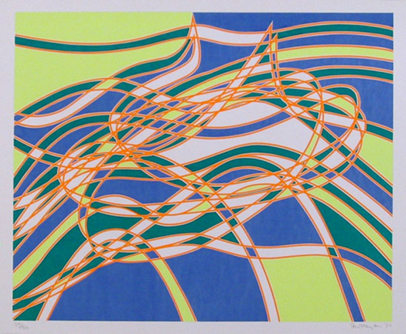
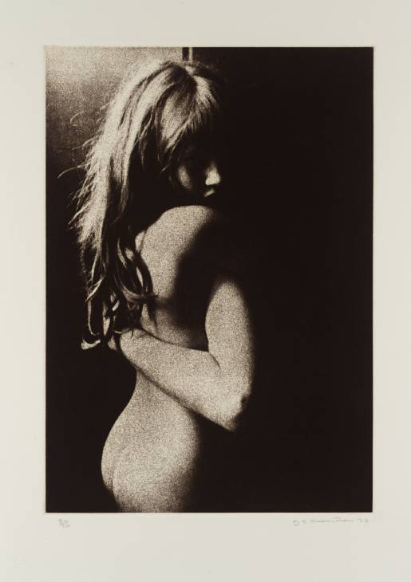
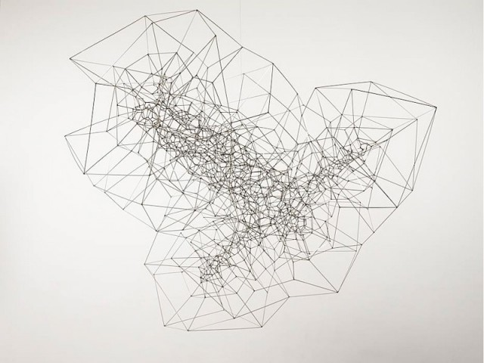
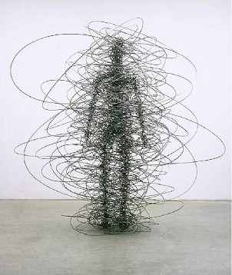
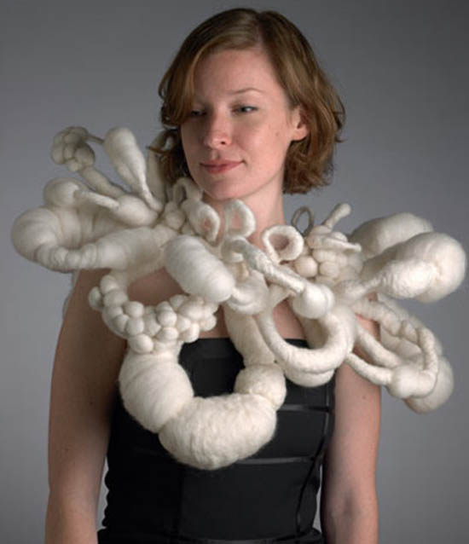
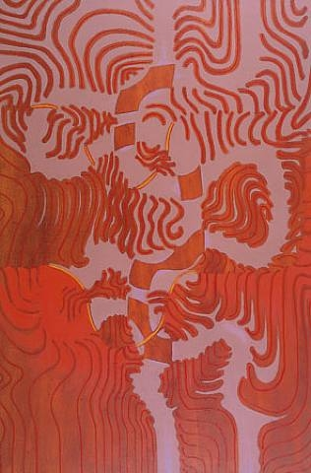
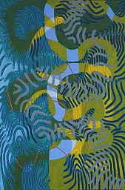
Twisted and Intertwined
Stanley Hayter
Joan
Baxter
Graham Ovenden
Little Lorraine 1970
Antony Gormley
Hisano Takei
Bryan Wynter

Slide 2
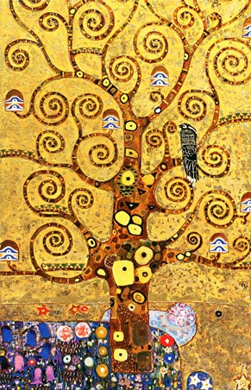
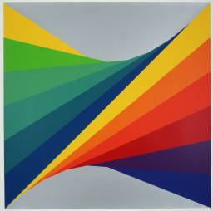
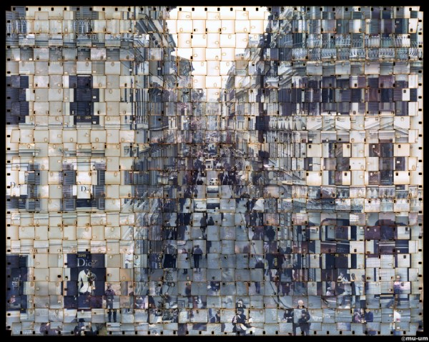
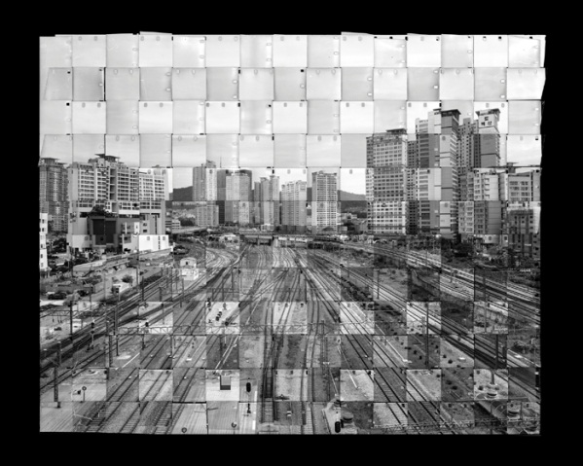
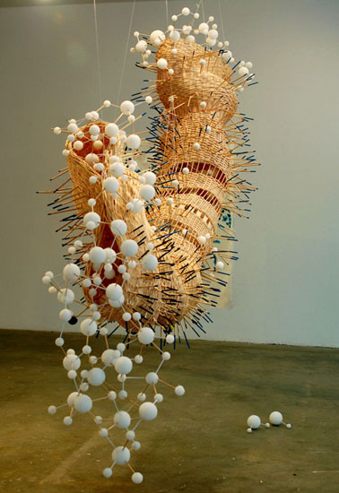
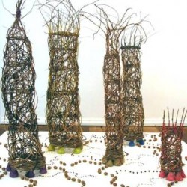
Twisted and Intertwined
Seung Hoon Park Woven Photography
Herbert Bayer
Gustav Klimt
Natale Miebach
Wanda Bennett weaving textiles
Hans Breder

Slide 3
, Andrea Hunter and Karen Kulyk
William Eggleston
http://www.bideford.devon.sch.uk/art/gcse07/viewpoints/index.html

Slide 4
Alevel galleries
http://frog.bideford.devon.sch.uk/index.phtml?d=170027
http://www.bideford.devon.sch.uk/art/galleries/alev_art_08/index.html
http://www.bideford.devon.sch.uk/art/art_images/galleries/a2%201/index2.html

