Slide 1
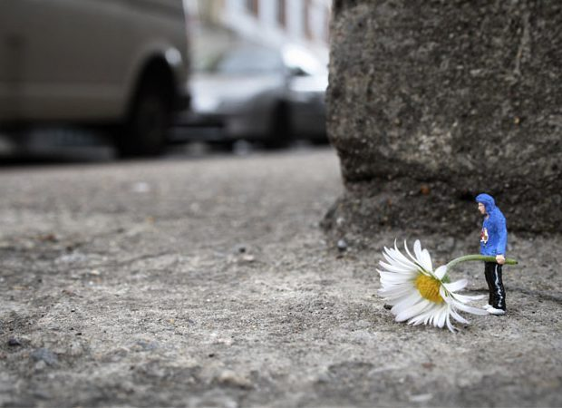
"I don't hang around to see what happens to the work," says Slinkachu, 31, a London-based former art director who prefers not to reveal his real name. "I don't want not to know. But there is a strange kind of buzz to abandoning your creations on the street."
Slinkachu
‘My 'Little People Project' started in 2006. It involves the remodelling and painting of miniature model train set characters, which I then place and leave on the street. It is both a street art installation project and a photography project. The street-based side of my work plays with the notion of surprise and I aim to encourage city-dwellers to be more aware of their surroundings. The scenes I set up, more evident through the photography, and the titles I give these scenes aim to reflect the loneliness and melancholy of living in a big city, almost being lost and overwhelmed. But underneath this, there is always some humour. I want people to be able to empathise with the tiny people in my works.’
Since 2006 this London-based artist has been installing tiny dioramas in cities around the world, taking photographs – then leaving their work to be kicked or ignored or taken away.

Slide 2
