Slide 1
PLACES

Slide 2
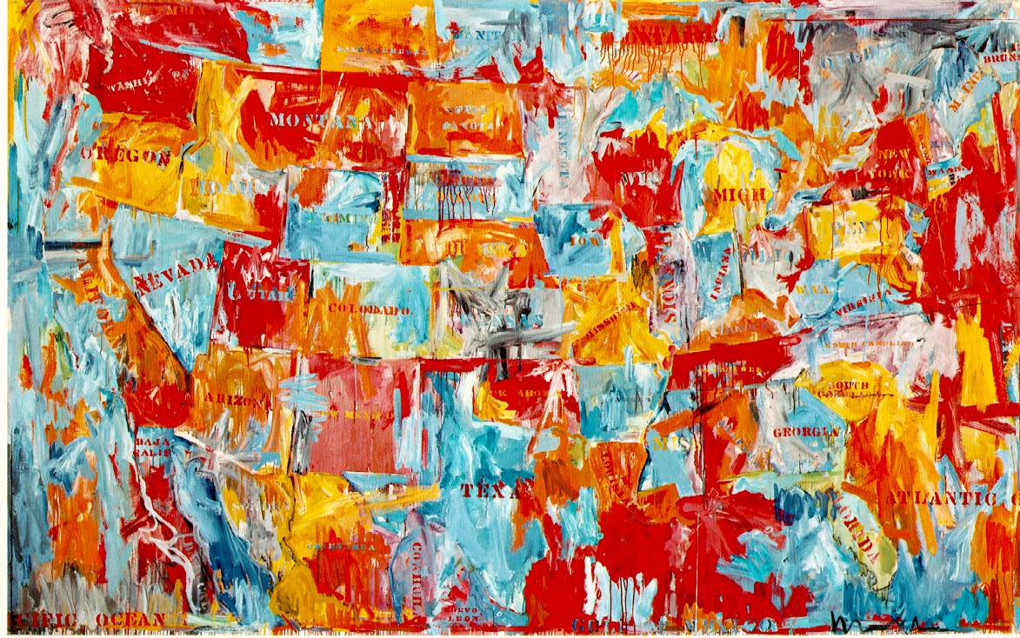
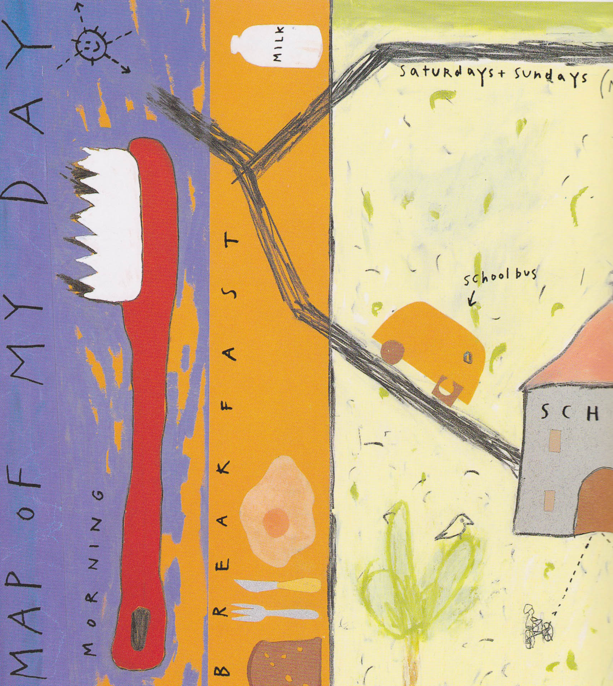
Maps
Jasper Johns
Sarah Fanelli
‘Map’ 1961 Oil on canvas
‘Map’ combines a kind of representation, that is, a map of the United States, with many issues more common to abstract painting. Johns combines colour, lines, and readable gestures (brushstrokes), as well as letting paint speak for itself on flat canvas surfaces.
“Map of my Day” 1995

Slide 3
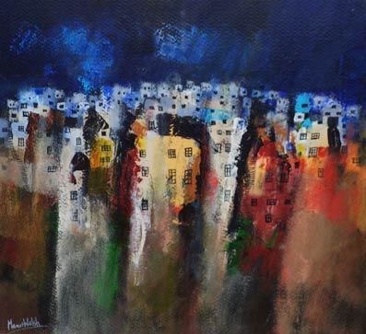
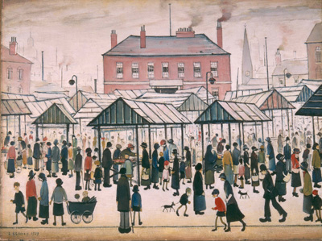
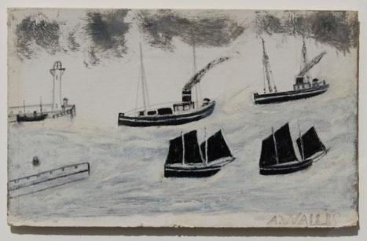
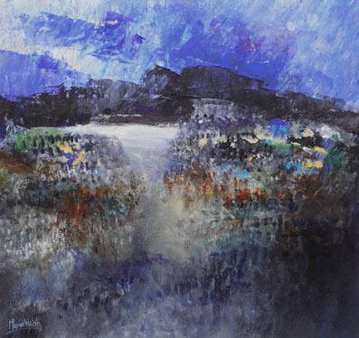
LS Lowry - Market Scene, Northern Town, 1939
Manus Walsh
Alfred Wallis

Slide 4
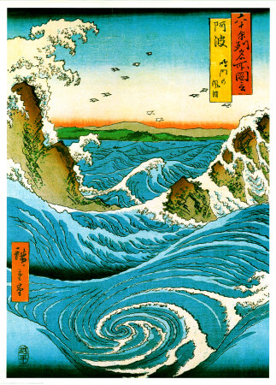
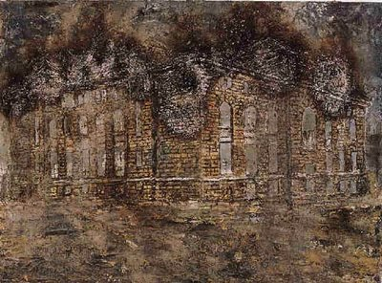
Anselm Kiefer – ‘Athanor’. Mixed media textural painting.
Can the materials that you use give the place you are depicting a certain mood or feeling?
Ando Hiroshige – Japanese woodblock prints, exaggerating the shapes and pattern seen within a natural landscape. (Ukiyo-e)

Slide 5
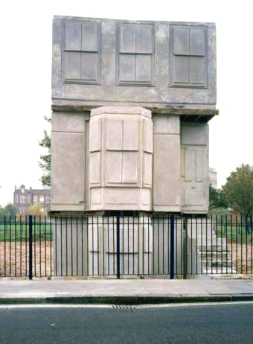
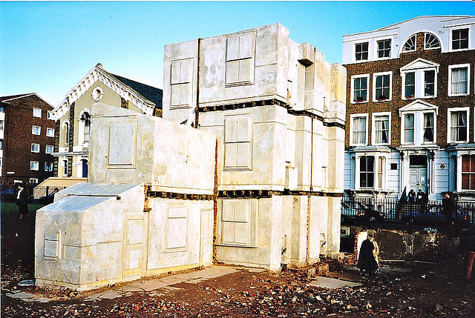
Rachel Whiteread – ‘House’ 1993.
A concrete cast of the inside of an entire Victorian terraced house, exhibited at the location of the original house — 193 Grove Road — in East London (all the houses in the street had earlier been knocked down by the council).
It also won the Turner Prize in 1993. Tower Hamlets London Borough Council demolished House on 11 January 1994.

Slide 6
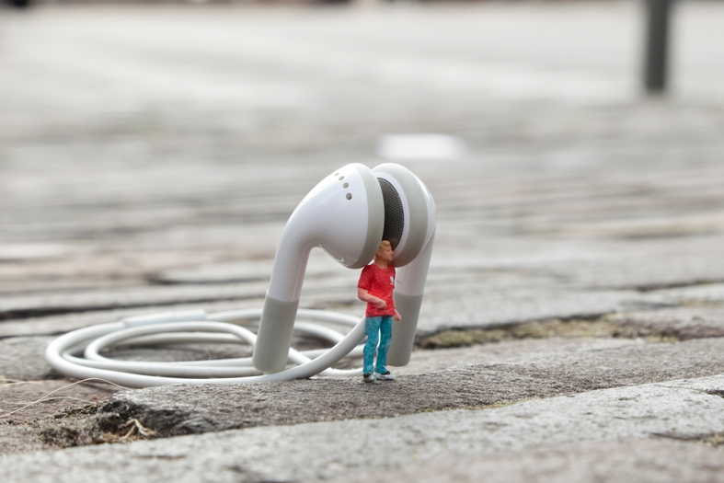
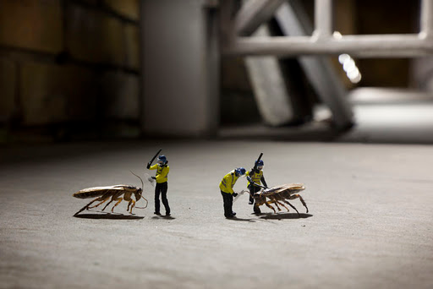
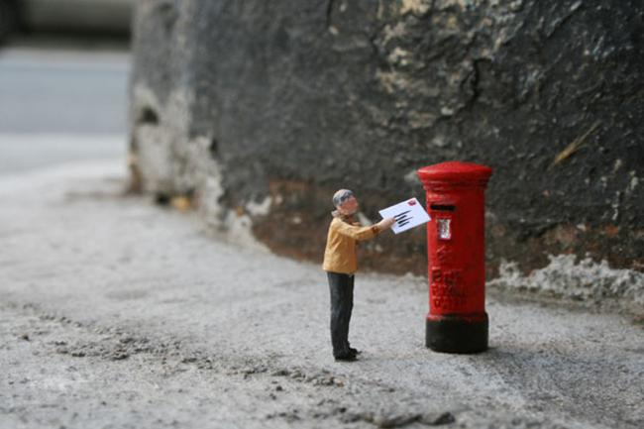
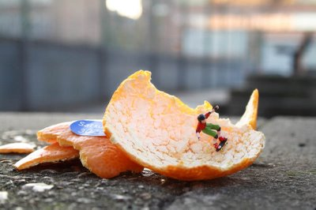
Slinkachu- Little worlds
Slinkachu is as a London-based artist who creates very small street-based installations and then photographs them: from far away and up-close.

Slide 7
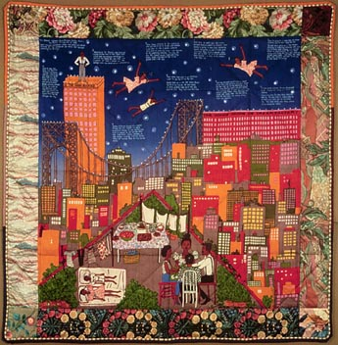
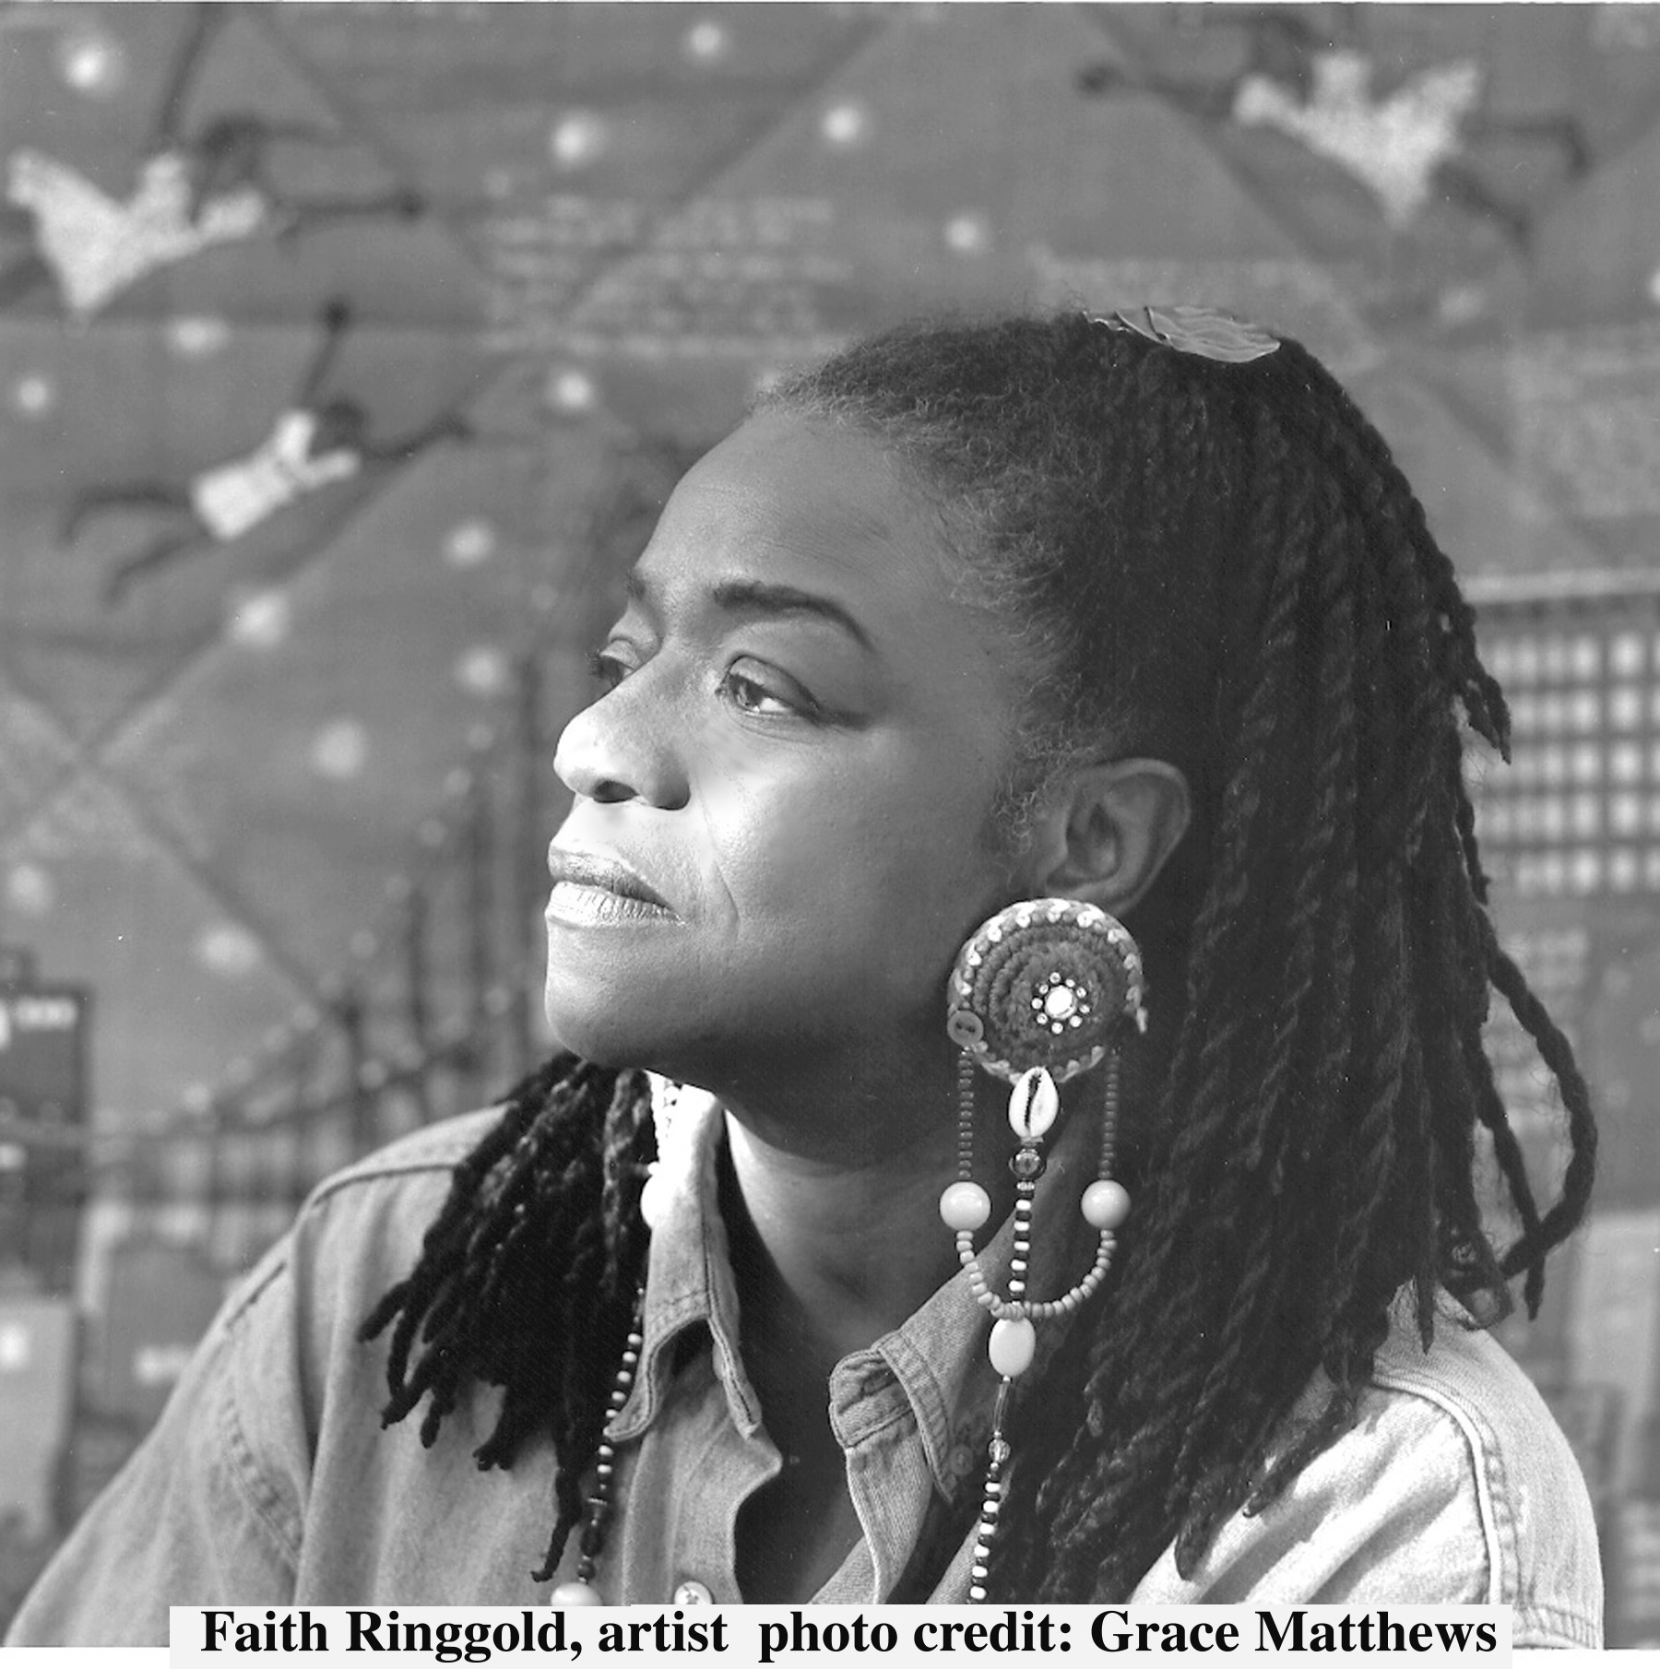
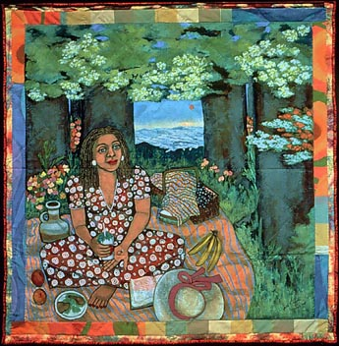
Faith Ringgold African American
Tar Beach 2 1990 Silkscreen on silk 66 x 66"

Slide 8
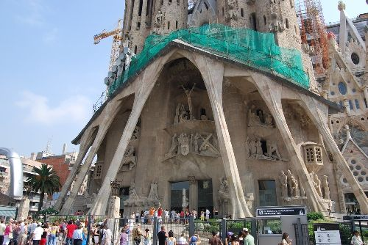
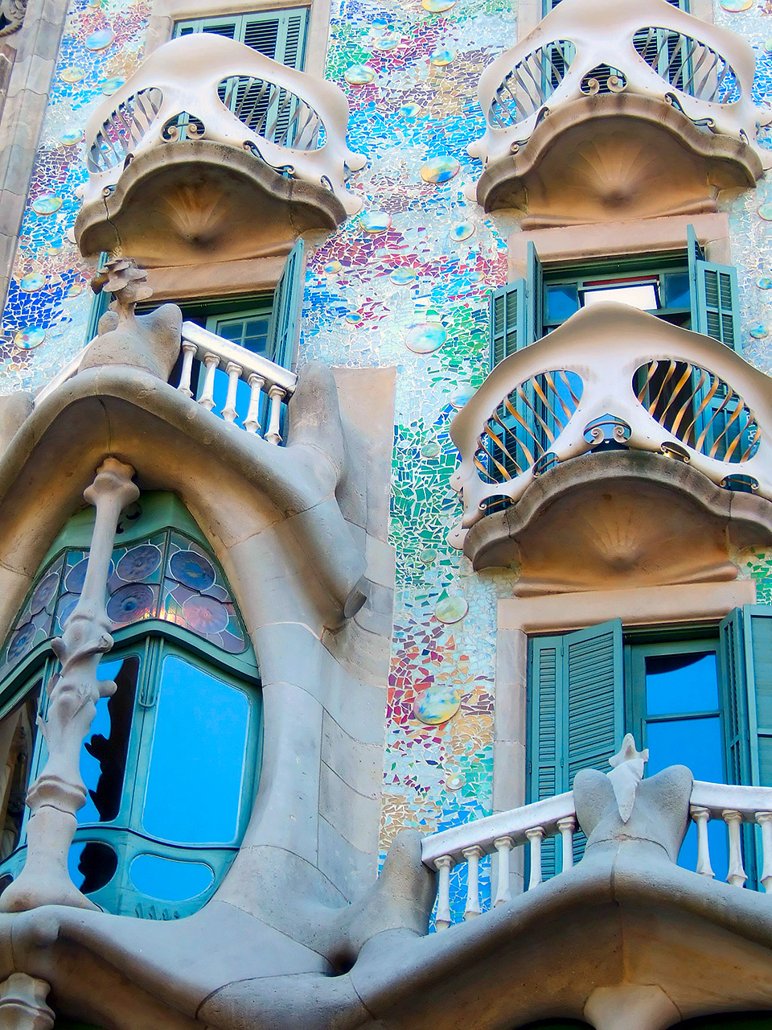
Gaudi
The most famous of Gaudi’s work, this church in Barcelona has been in construction for more than 100 years. Gaudi was a devout Catholic and spent over 10 years working just on this project.

