Slide 1
NATURAL WORLD

Slide 2
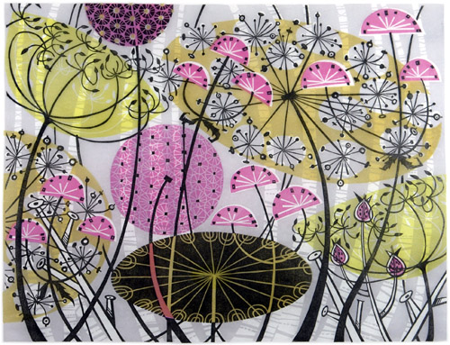
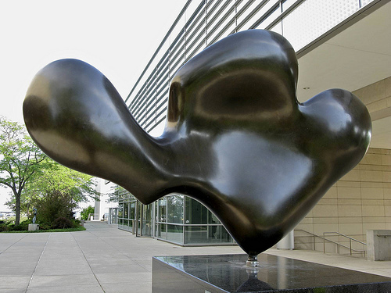
Jean Arp- Feuille se Reposant (Resting Leaf) 1959
Angie Lewin - Printmaking

Slide 3
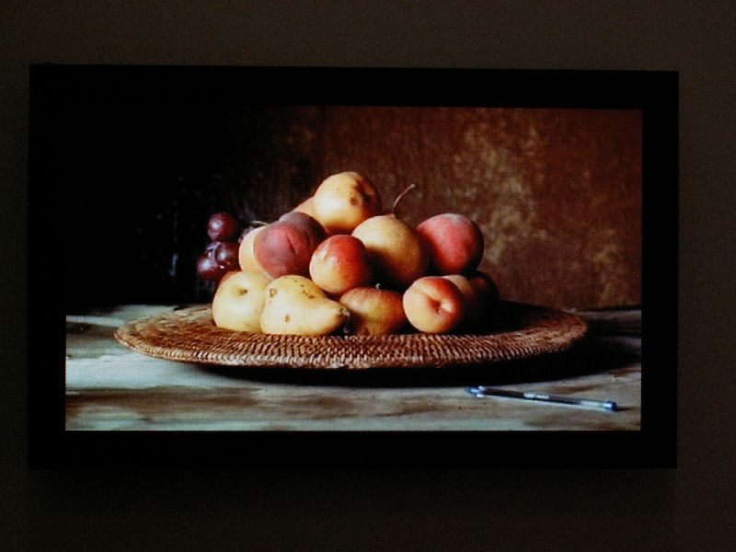
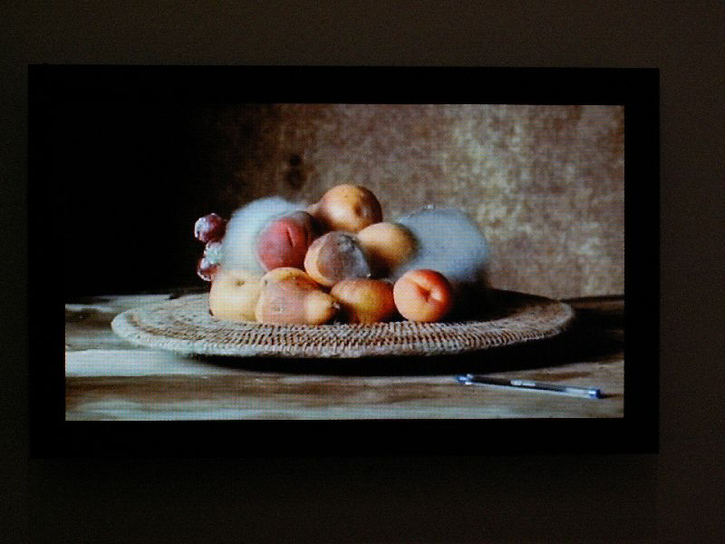
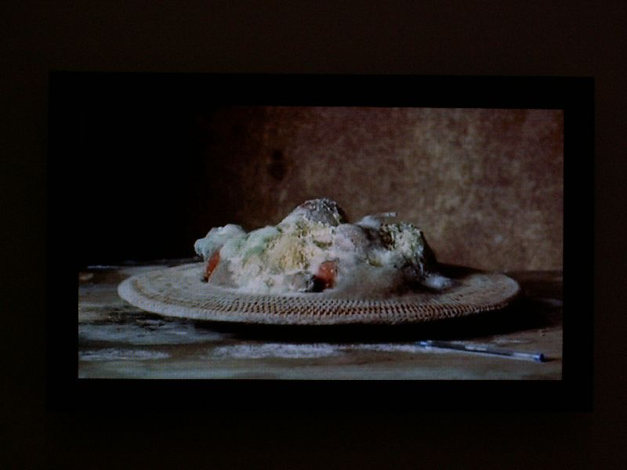
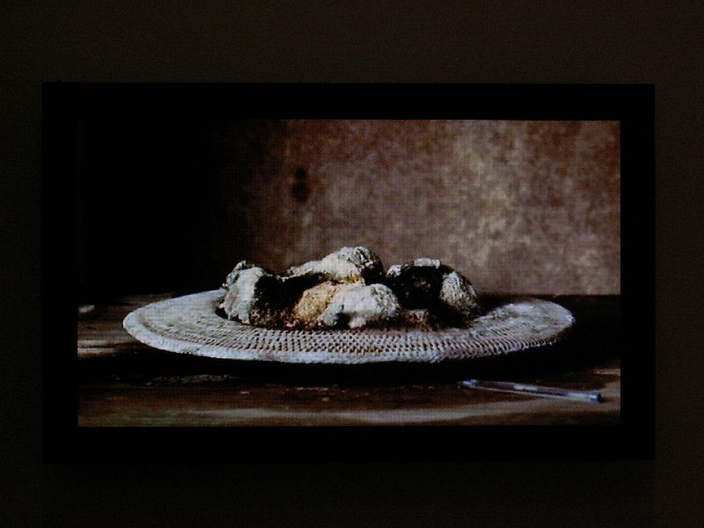
Sam Taylor-Wood

Slide 4
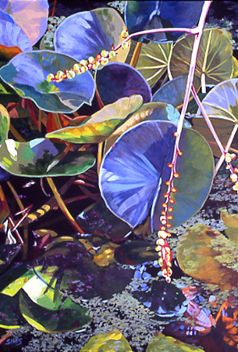
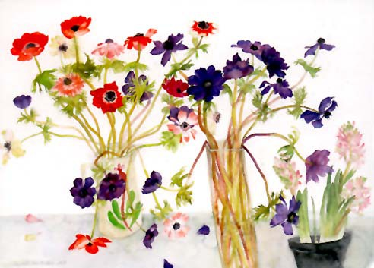
Elizabeth Blackadder – botanical drawing and painting.
Carol Sims – acrylic on canvas

Slide 5
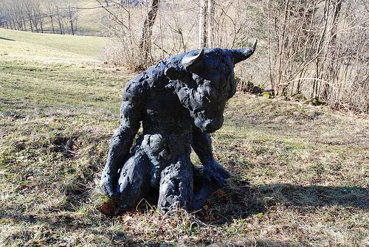
Sophie Ryder

Slide 6
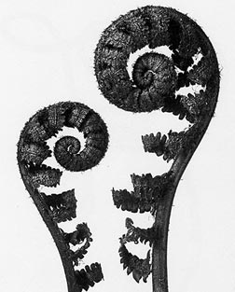
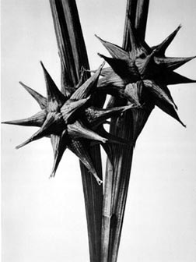
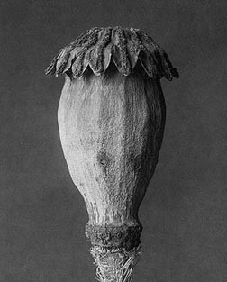
Karl Blossfeldt
Monochrome photography of natural forms such as flowers, seed pods.

Slide 7
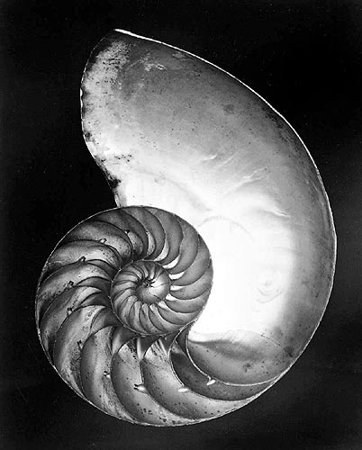
Edward Weston
Weston explored natural form through black and white photography.
Shell, 1927 Vintage gelatin silver print

Slide 8
Andy Goldsworthy
1956 - present
Andy Goldsworthy is a British artist who works with nature, natural form and the natural environment to make his creations.
(to the right) Carefully broken pebbles scratched white with another stone St. Abbs, Scotland 1 June 1985

Slide 9
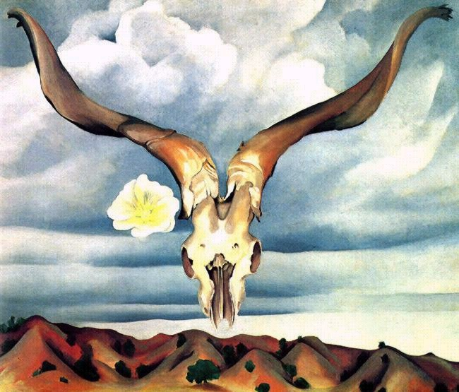
Georgia O’Keefe
O’Keefe’s paintings are beautifully contoured forms, realistically painted but using unusual combinations of objects.
She expertly painted subtle tones and colours.
Ram's Skull, Oil Painting, 1935

Slide 10
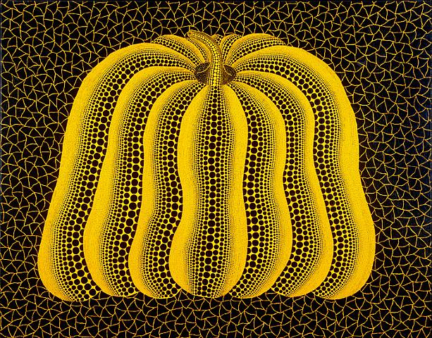
Yayoi Kusama 1929 - present
PUMPKIN (TOTW) Acrylic on canvas 2003
Kusama is a Japanese American artist who works in a wide variety of media and techniques – prints, sculptures and installations.
Her starting point is often natural form.

Slide 11
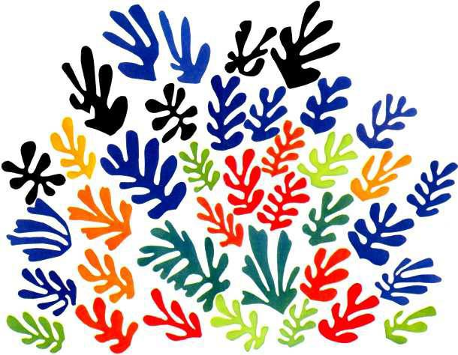
Henri Matisse
La Gerbe, one of Matisse's latest works (1953).

Slide 12
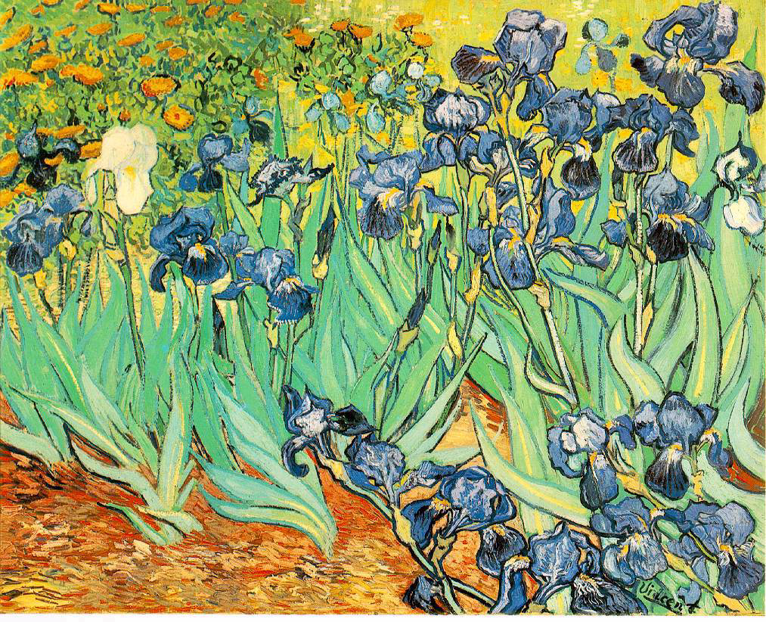
Vincent Van Gogh
1953 - 1890
Vincent Van Gogh was a Dutch post-Impressionist painter whose work has far-reaching influence on 20th Century art due to its vivid colours and emotional impact.
"Irises” Oil Painting 1889

Slide 13
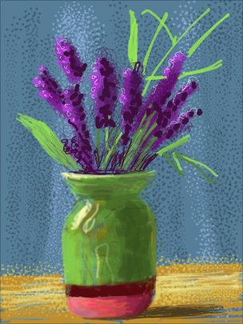
David Hockney
Hockney’s recent work has been created on his ipad and his iphone this one is considering the Natural World
Below is the Royal Academy website
http://www.royalacademy.org.uk/exhibitions/hockney/
Exhibition at the Royal Academy London -21 January - 9 April 2012

Slide 14
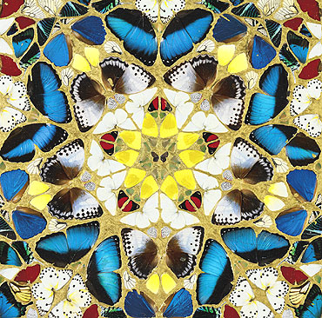
Damien Hirst
1965 to present
Hirst explores the uncertainty at the core of human experience; love, life, death, loyalty and betrayal through unexpected and unconventional media.
Psalm 27: Hirst's butterfly and enamel paint on canvas

