Slide 1
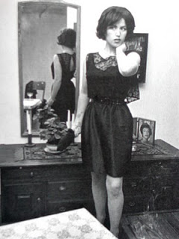
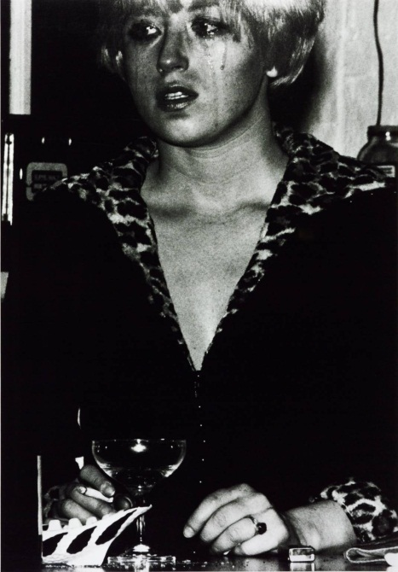
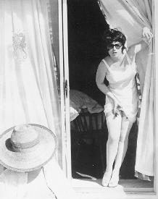
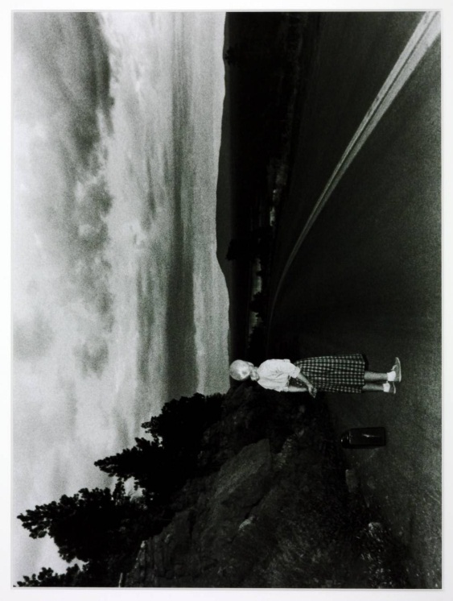

Slide 2
Cindy Sherman’s Untitled Film Stills
Untitled Film Stills is a series of sixty-nine black-and-white photographs made between 1977 and 1980. In them Sherman appears as fictitious characters in scenarios resembling moments in a film. She used vintage clothing, wigs and makeup to create a range of female personae which she then photographed in apparently solitary, unguarded moments of reflection, undress, or in conversation with somebody off-set and outside of the frame. The ‘stills’ are set in a variety of interior locations as well as outside in urban and rural landscapes. They were begun shortly after Sherman moved to New York city with the artist Robert Longo (born 1953). Sherman studied art at the State University College at Buffalo, New York between 1972 and 1976, producing a series of black and white photographs which resulted in Untitled A, B, C and D 1975 (Tate P11437-40). The following photographic series, Bus Riders 1976 (Tate P78495-508 and P78535) and Murder Mystery Series 1976, are the direct precursors to the Film Stills. Sherman has commented:
‘In college I began to collect a lot of discarded accoutrements from the 1940s, 1950s and 1960s, more for my own personal wardrobe as well as for the sheer fascination with what those garments stood for. It was easy and cheap to collect all kinds of things in those days. I’ve always played with make-up to transform myself, but everything, including the lighting, was self taught. I just learned things as I needed to use them. I absorbed my ideas for the women in these photos from every cultural source that I’ve ever had access to, including film, TV, advertisements, magazines, as well as any adult role models from my youth. The resulting photo shoots were very brief. In those naïve days, I would sometimes take only about six shots for one scene and move on to the next, so that with one roll of film I could have six different set-ups.’ (Quoted in Contemporary Art: The Janet Wolfson de Botton Gift, p.99.) Initially Sherman photographed the Film Stills in the loft apartment where she and Longo lived. She took many of the pictures herself using an extended shutter release; others, particularly those set in outdoor locations, required a second person to take the photograph, such as her boyfriend, friends or family. Sherman’s father took #48, in which she appears as a vulnerable young woman waiting with a suitcase at the side of a darkening country road.
Real film stills are not stills from the actual film but are photographs taken to encapsulate aspects of the film for advertising purposes, to be shown on billboards or in magazines or newspapers. Sherman has explained that she titled this series of images ‘film stills’ ‘mostly because I was thinking of publicity stills like you’d see around 42nd Street, in boxes of hundreds of them for thirty-five cents each’ (quoted in Taylor, p.78). She has said that her intention was that they would ‘seem cheap and trashy ... I didn’t want them to look like art’ (quoted in Tomkins, p.78). Like real movie stills Sherman’s images evoke events in possible narratives which the viewer may invent or interpret in different ways, suggesting an original which never in fact existed. Like all of Sherman’s photographic series, they provide a range of fictional portraits, usually of women, in which the artist operates as actress, director, wardrobe assistant, set designer and cameraman.

