Slide 1
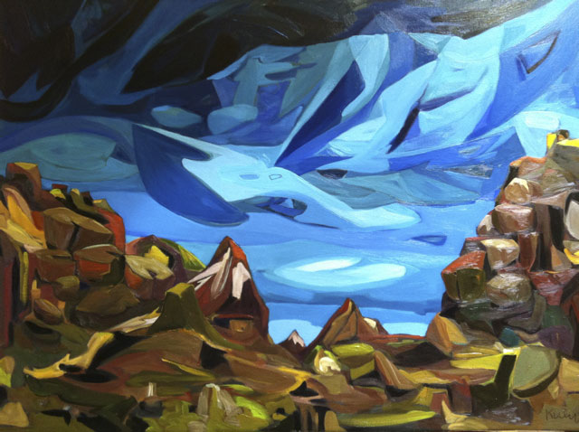
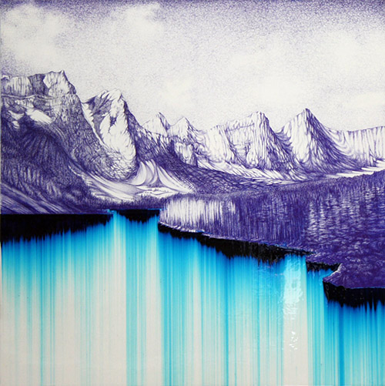
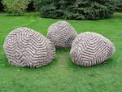
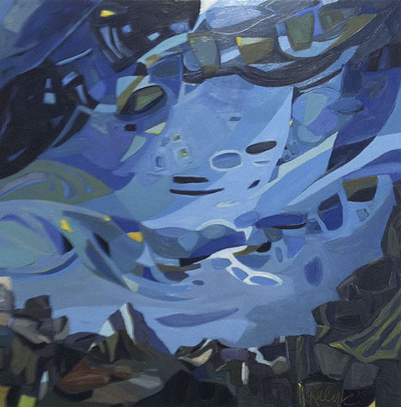
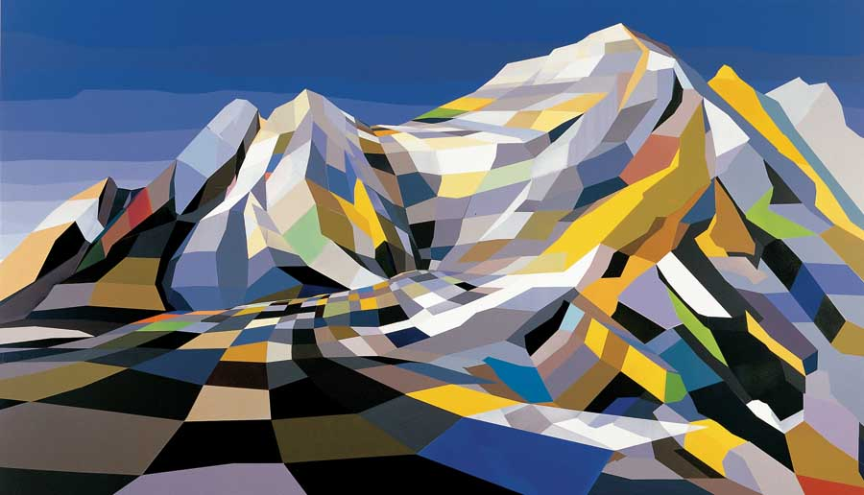
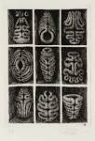
The Natural Environment
Shane McAdams
Peter Randall
Page
Torben Giehler
Karen Kulyk
Andrea Hunter
(felt)

Slide 2
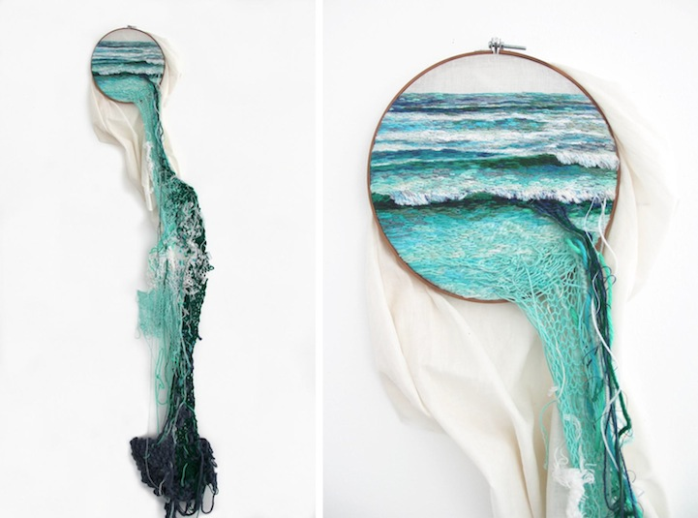
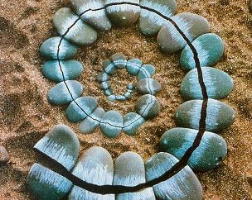
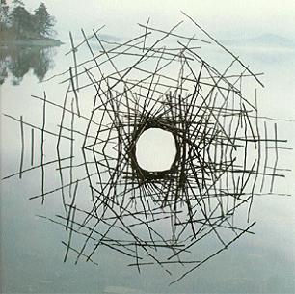
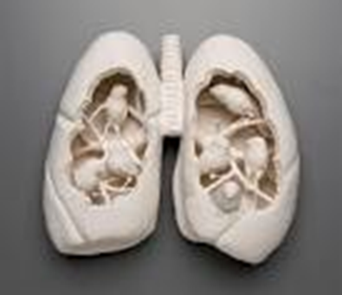
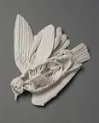
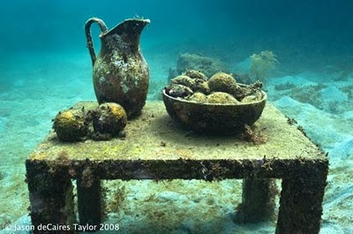
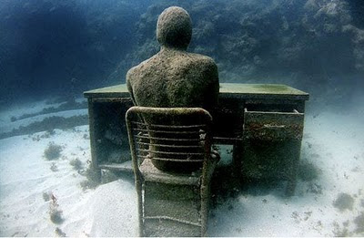
The Natural Environment
Ana
Teresa
Barboza
Andy Goldsworthy
Maki
Ohkojima
Jason DeCaires
Kate McDowell

Slide 3
, Andrea Hunter and Karen Kulyk
William Eggleston
http://www.bideford.devon.sch.uk/art/gcse07/viewpoints/index.html

Slide 4
Alevel galleries
http://frog.bideford.devon.sch.uk/index.phtml?d=170027
http://www.bideford.devon.sch.uk/art/galleries/alev_art_08/index.html
http://www.bideford.devon.sch.uk/art/art_images/galleries/a2%201/index2.html

