Slide 1
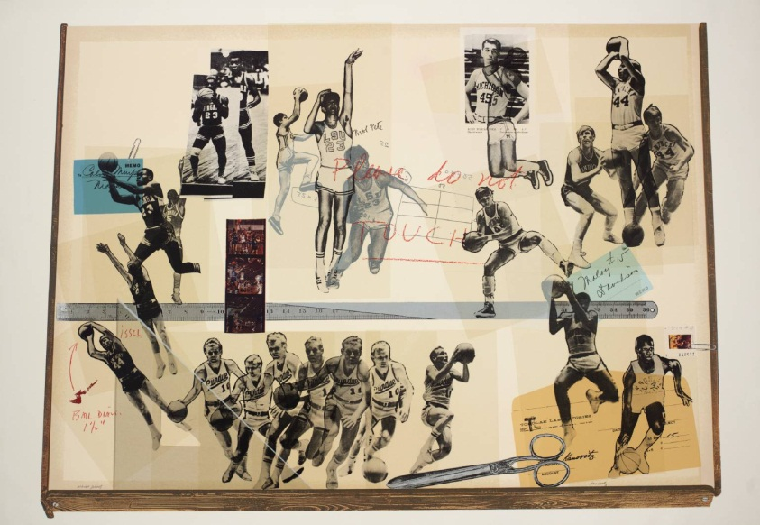
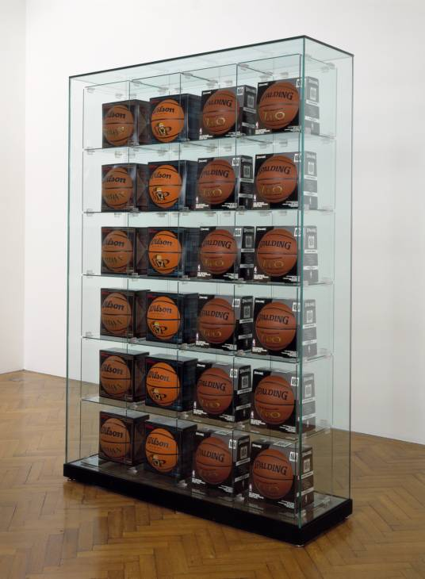
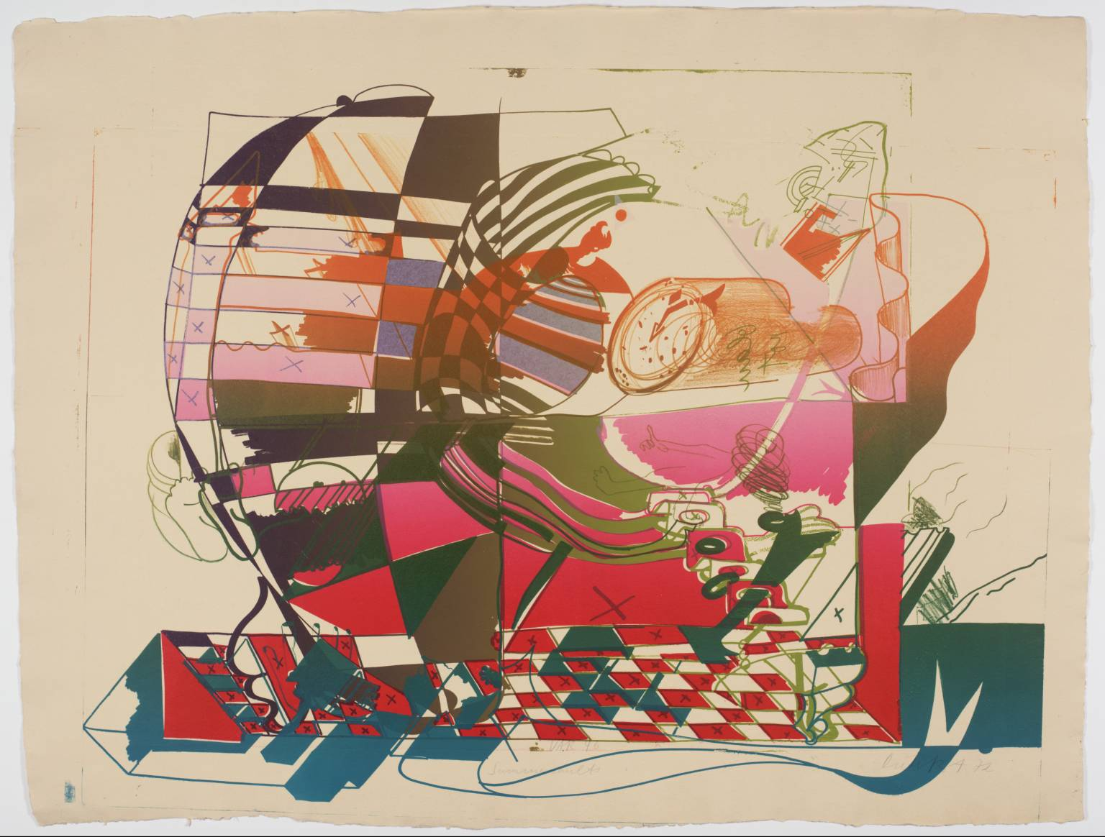
Sporting Events
Howard Kanovitz
Basketball Pinboard
Gustav klutsis
Jeff Koons
Dieter Roth – Double Somerset

Slide 2
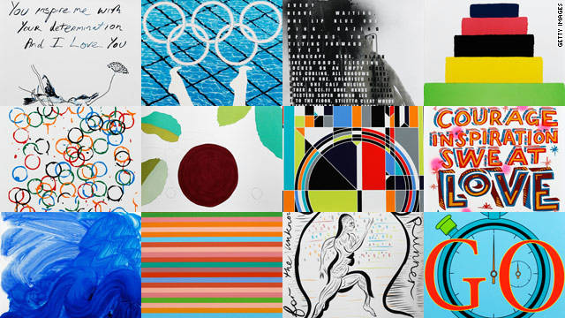
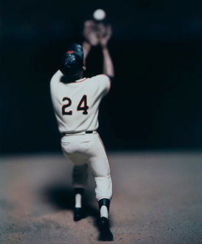
2012 olympics posters

Slide 3
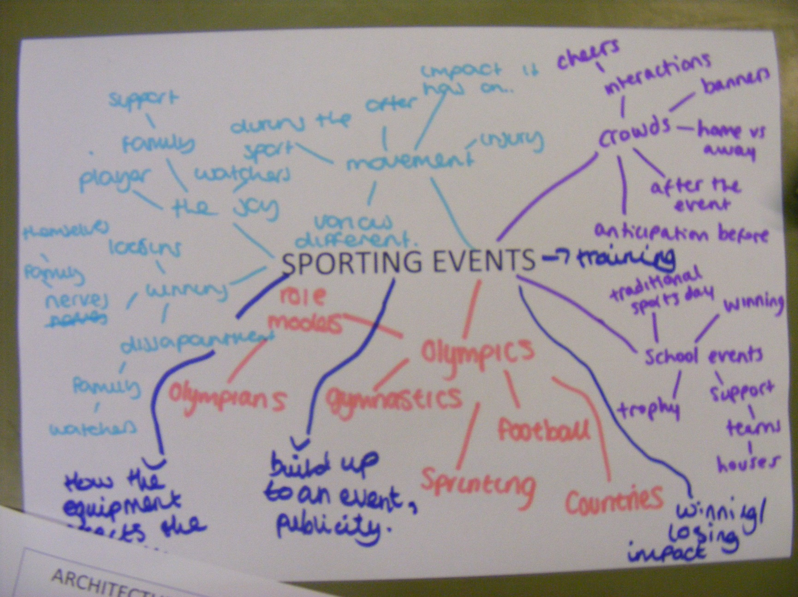
SPORTING EVENTS

