Slide 1
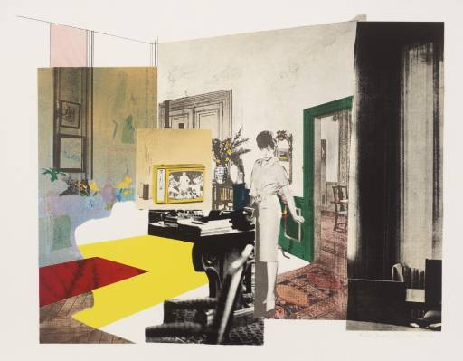
Hamilton claimed that any interior is 'a set of anachronisms, a museum, with the lingering residues of decorative styles that an inhabited space collects.' In this print, he contrasts an elaborately decorated interior with uncluttered coloured planes reminiscent of modernist architecture and design. The clash of styles is also reflected in his combination of painting with silkscreen printing, a technique associated with commercial art that allowed the direct transfer of photographic images onto canvas.
Richard William Hamilton (24 February 1922 – 13 September 2011) was a British painter and collage artist. His collage ‘Just what is it that makes today’s homes so different, so appealing?’ of 1956 is considered by critics and historians to be one of the early works of the Pop Art movement.
Interior 1964-5

Slide 2
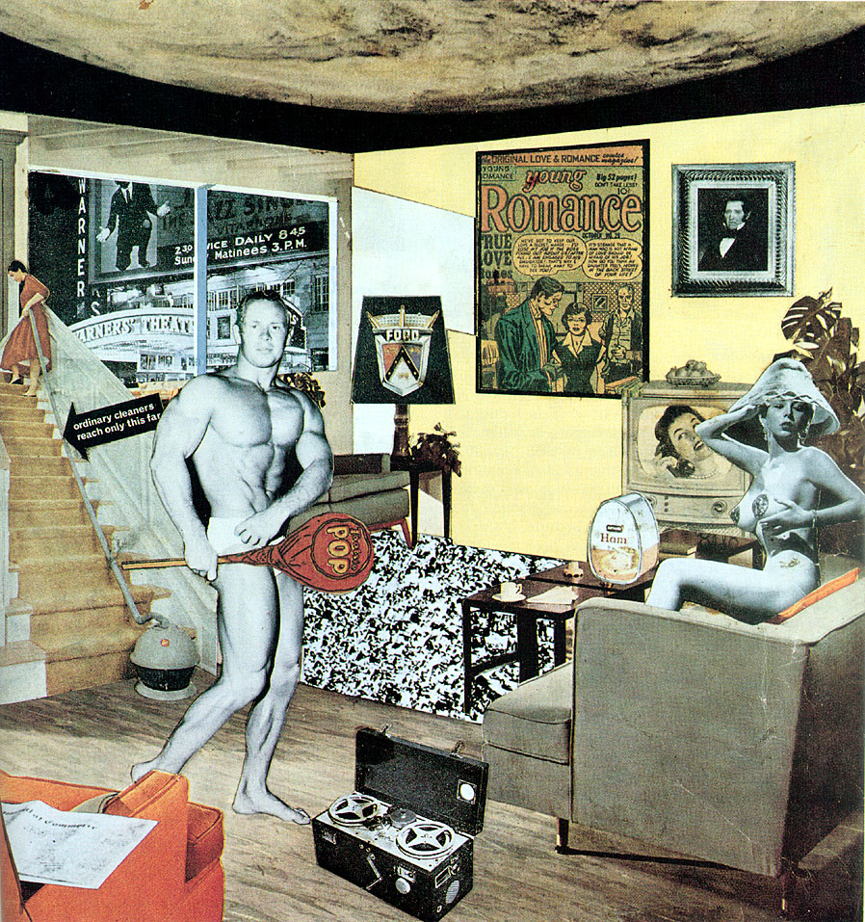
Hamilton created collages by incorporating advertisements from well-known magazines and newspaper. He used this technique in his painting, Interior. Through an advanced layering of painting and photographic techniques, he continues to examine issues of illusion and the processes of image-making. Hamilton was also eager to explore new technologies, and has experimented with computer-generated imagery since the 1980s.
Hamilton scrutinizes a motif through a variety of medium, reiterating and reinterpreting from collage to painting to print, combining techniques.
He has explored nearly every process except relief, including screen print, collotype, intaglio and digital formats and first tried etching in 1939. He remains preoccupied with photography and issues of reproduction, but his more than two hundred print range from photographic images, intricate hand-drawn pieces and mechanical manipulations. He has also teamed up with master printers around the world in order to achieve these effects.

