Slide 1
PEOPLE

Slide 2
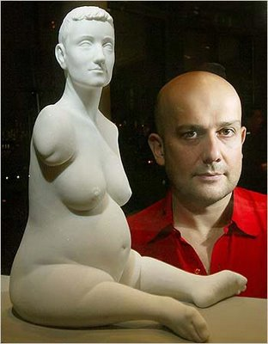
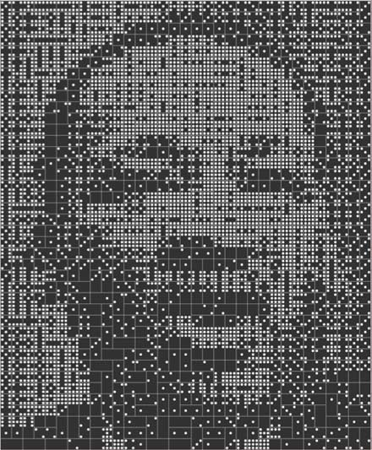
Marc Quinn
Robert Bosch
Portrait of Martin Luther King made out of dominoes.
Quinn is inspired to work with physical deformity. Looking at fragmented sculptures in the British Museum, he wondered how viewers would respond to bodies that had been damaged during their lifetime rather than after being transformed into objects through artistic representation.

Slide 3
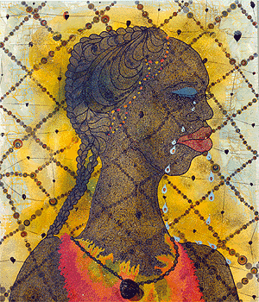
Chris Ofili
No Woman No Cry 1998. Uses mixed media,
including elephant dung!

Slide 4
Andy Warhol
‘Elvis. 1962’. Screenprinting on silk. At that time Elvis was seen everywhere- on TV, magazines, newspapers. The way his image is repeated over and over seems like a comment on that. The fact that the image of Elvis seems to be fading away could be significant...

Slide 5
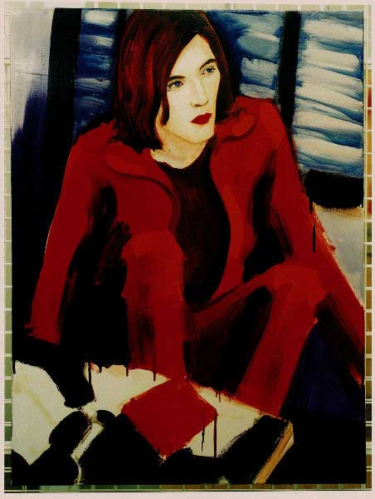
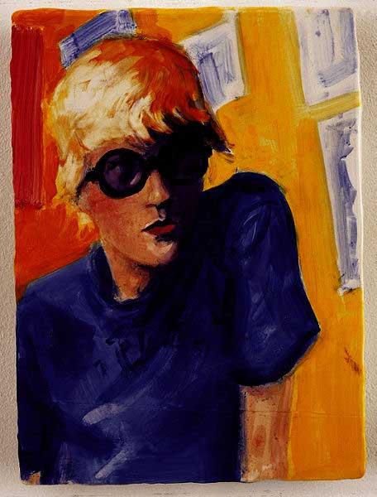
Elizabeth Peyton
Peyton painted numerous celebrities in her distinct style which renders each of her models with the same red lips, defined eyes and pale skin.
To the right a good weblink for MOMA gallery for this artist
http://www.moma.org/collection/artist.php?artist_id=8042

Slide 6
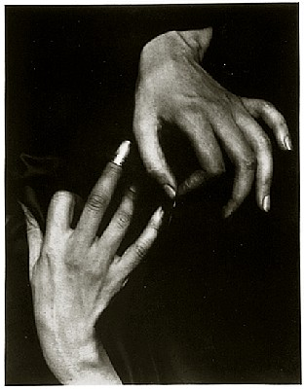
Alfred Stieglitz
Artist Georgia O’ Keeffe’s hands with thimble. An alternative way to make a portrait of somebody.

Slide 7
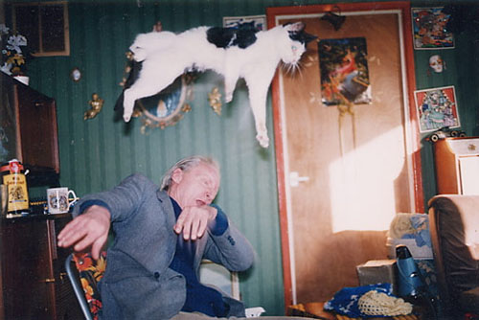
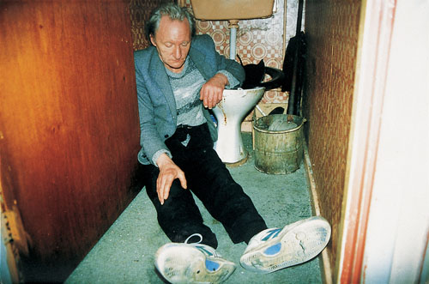
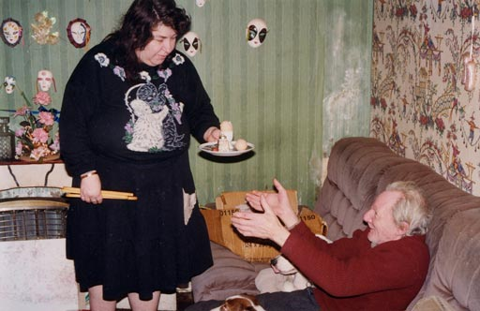
Richard Billingham
Richard Billingham's photographs of his family in their Birmingham flat, published in the book Ray's a Laugh 1996, are a stark, painful and often humorous study of the relationships within his own family. They encapsulate many of the critical questions relating to the position of the observer in relation to the observed.

Slide 8
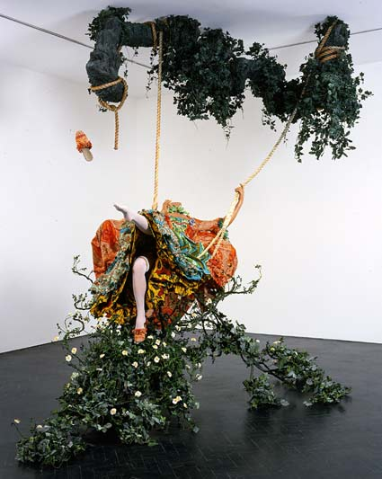
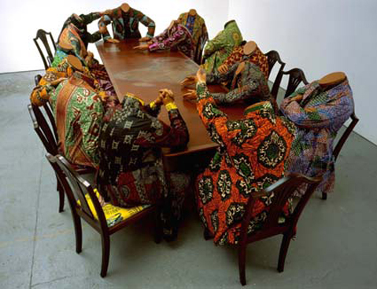
Yinka Shonibare
Fashion designer and sculpture artist. These pieces of work show a very surreal representation of the human form.
Scramble For Africa.
The Swing. 2001.

Slide 9
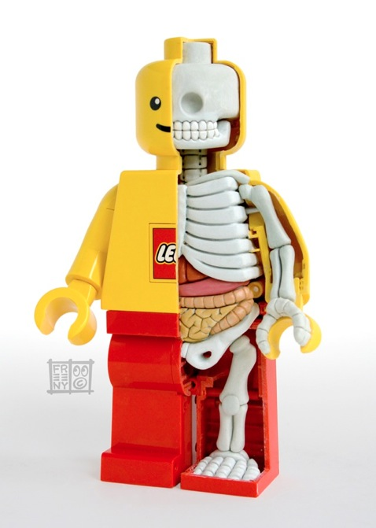
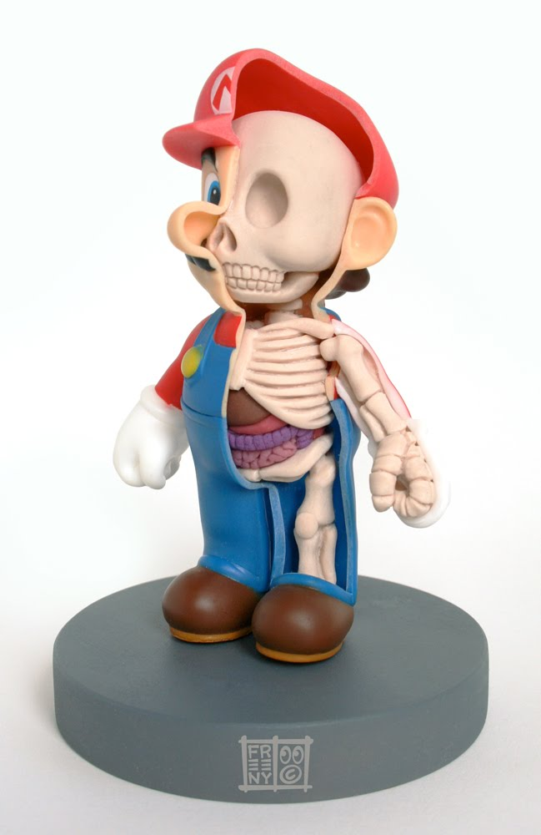
Jason Freeny – Contemporary sculpture

Slide 10
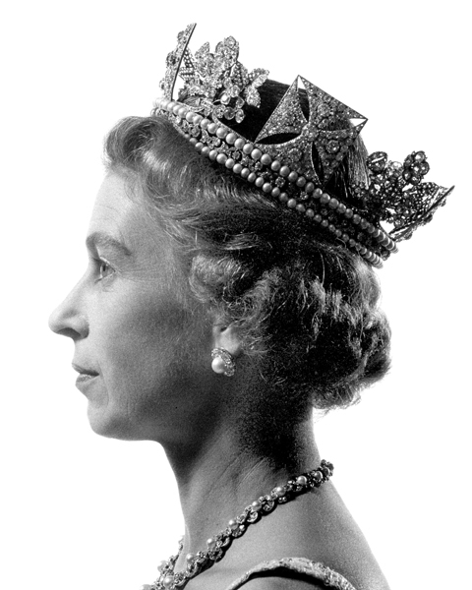
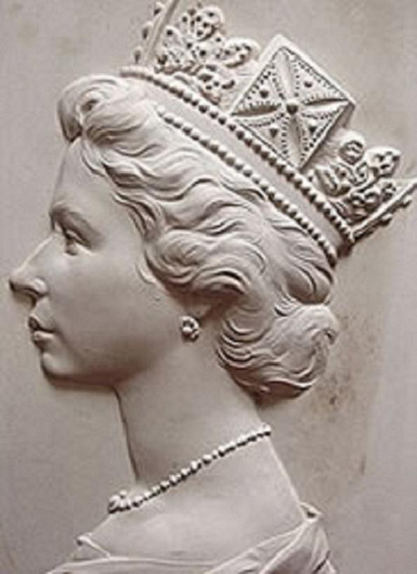
John Hedgecoe-
Took the photo of the Queen that is used on postage stamps
Arnold Machin – created the plaster cast of the Queen that is used on postage stamps
This is now a very ordinary sight as we see it all the time on coins and stamps.

Slide 11
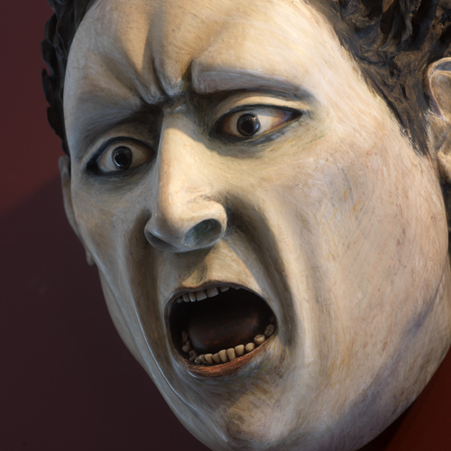
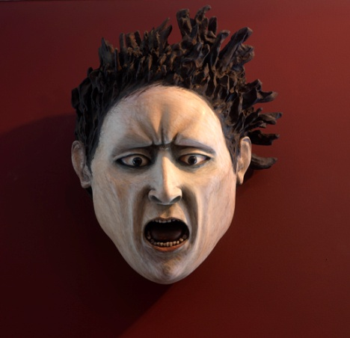
Ana Maria
Pacheco
Wall mounted wooden sculptures and dark, dry-point etching prints. 2011

Slide 12
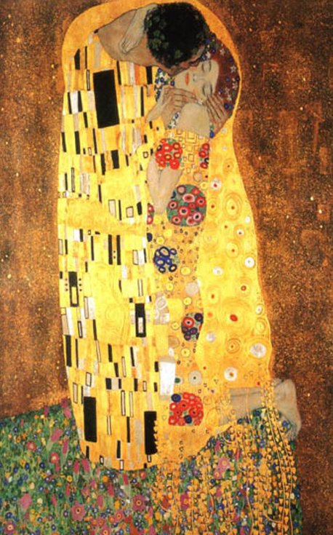
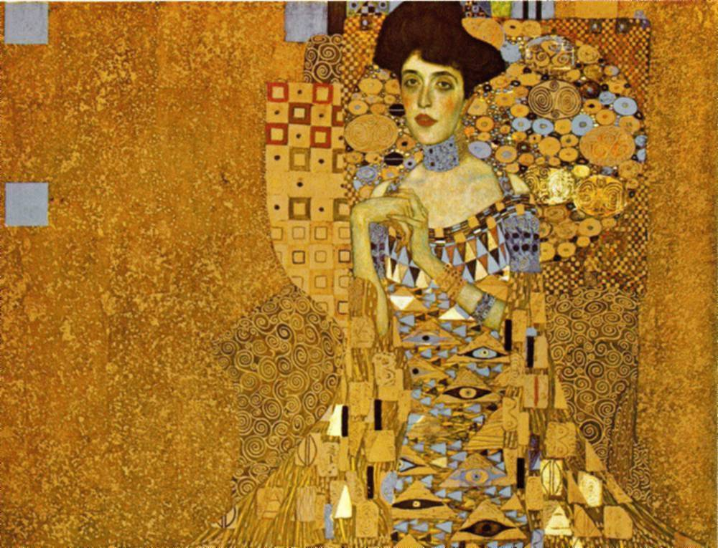
Gustav Klimt
Adele Bloch-Bauer 1907. Oil and gold on canvas. She is clasping her hands (she had a deformed finger). Dressed in gold, surrounded by gold. Lots of gold suggests she is wealthy and important.
The Kiss

Slide 13
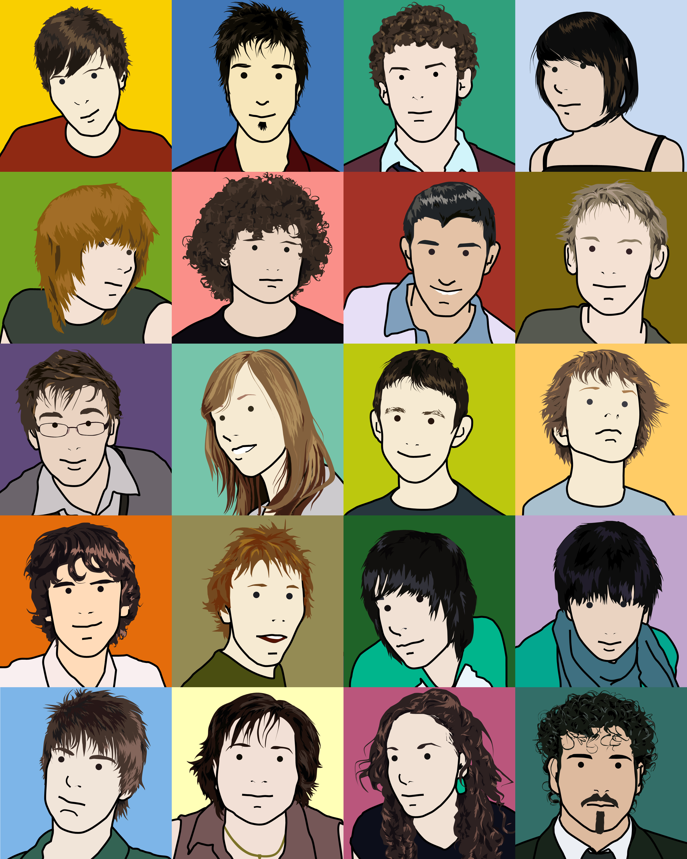
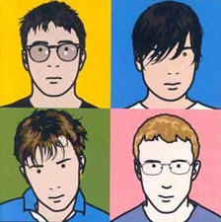
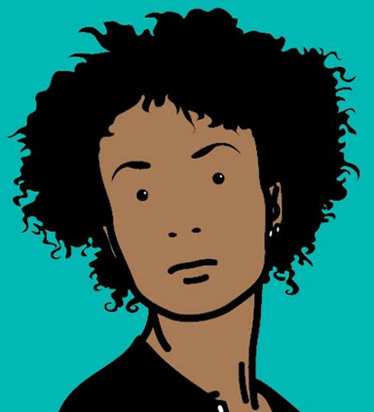
Julian Opi

Slide 14
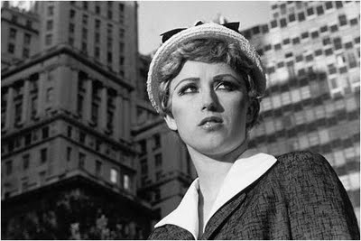
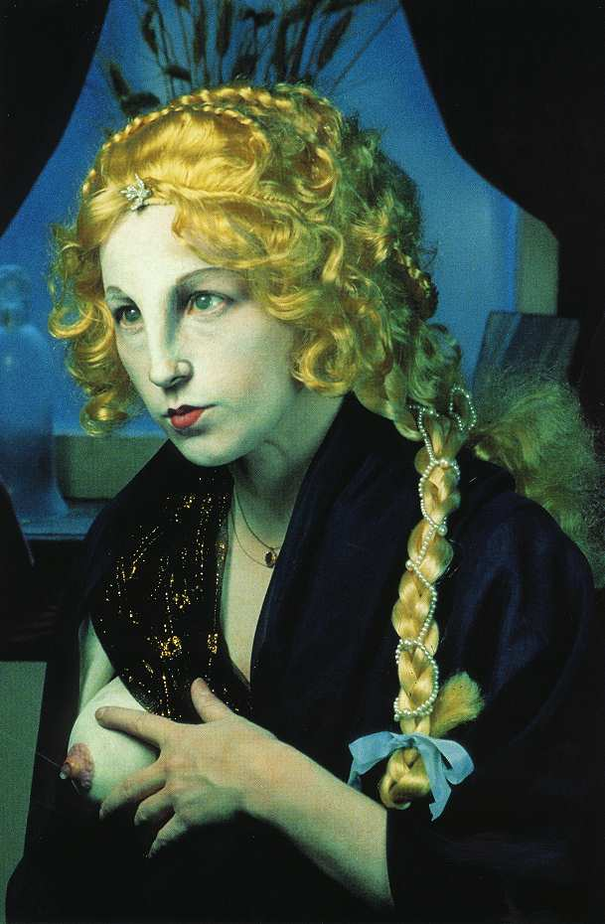
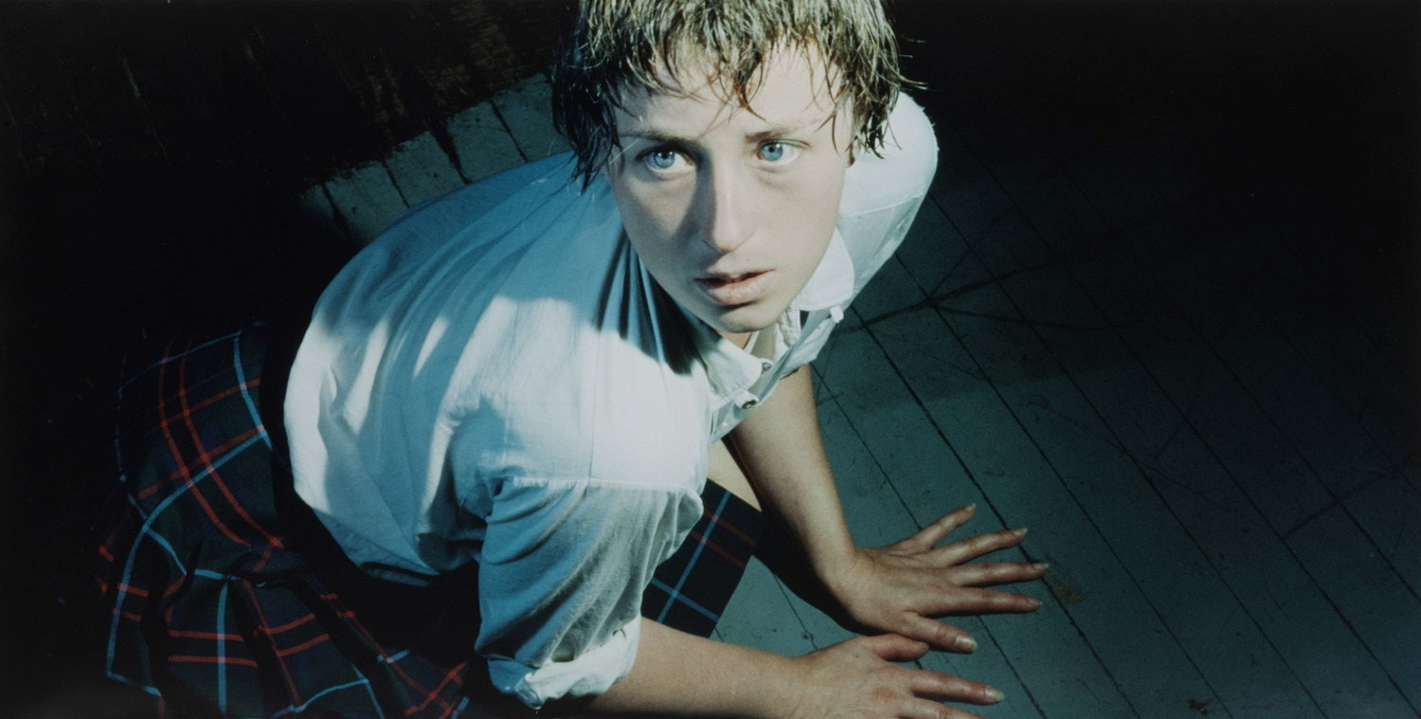
Cindy Sheerman
Sherman’s photographs are portraits of herself in various scenarios that parody stereotypes of women. A panoply of characters and settings are drawn from sources of popular culture, old movies, television soaps and pulp fiction.

Slide 15
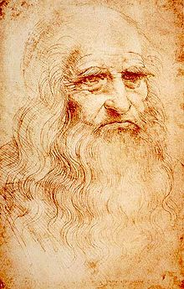
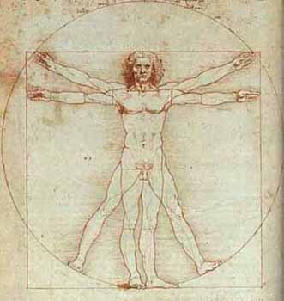
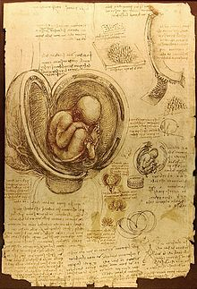
Leonardo da Vinci
Leonardo da Vinci (1452-1519) was an Italian Renaissance Artist among many other talents. He is widely considered to be one of the greatest painters of all time.

Slide 16
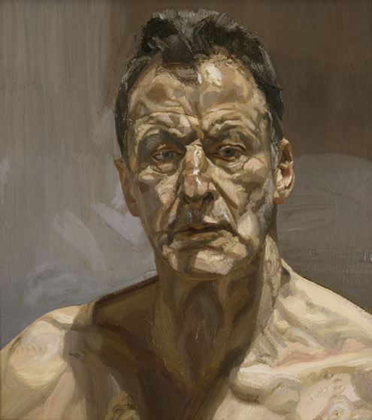
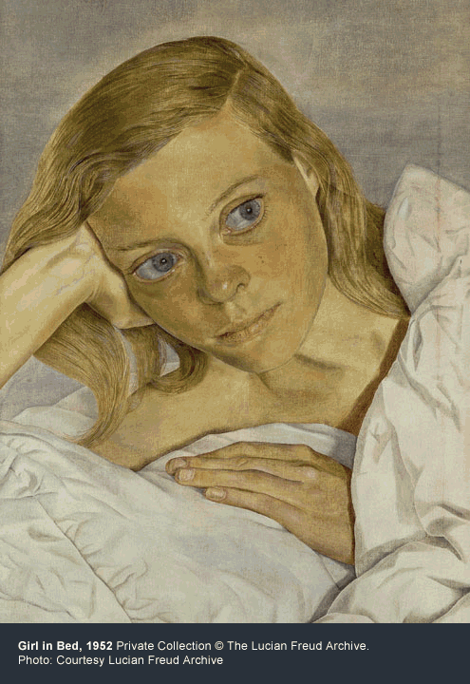
Lucin Freud
'I've always wanted to create drama in my pictures, which is why I paint people. It's people who have brought drama to pictures from the beginning. The simplest human gestures tell stories.'
Reflection (Self-portrait), 1985
Current exhibition on at the National Portrait Gallery London 9th Feb – 27th May
http://www.npg.org.uk/freudsite/

Slide 17
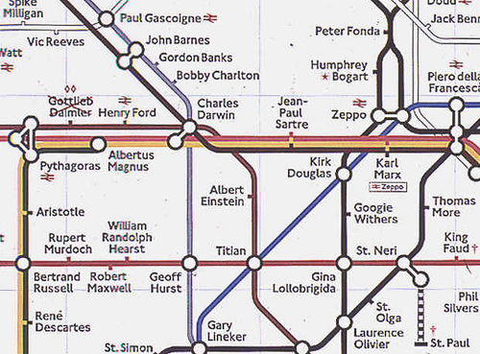
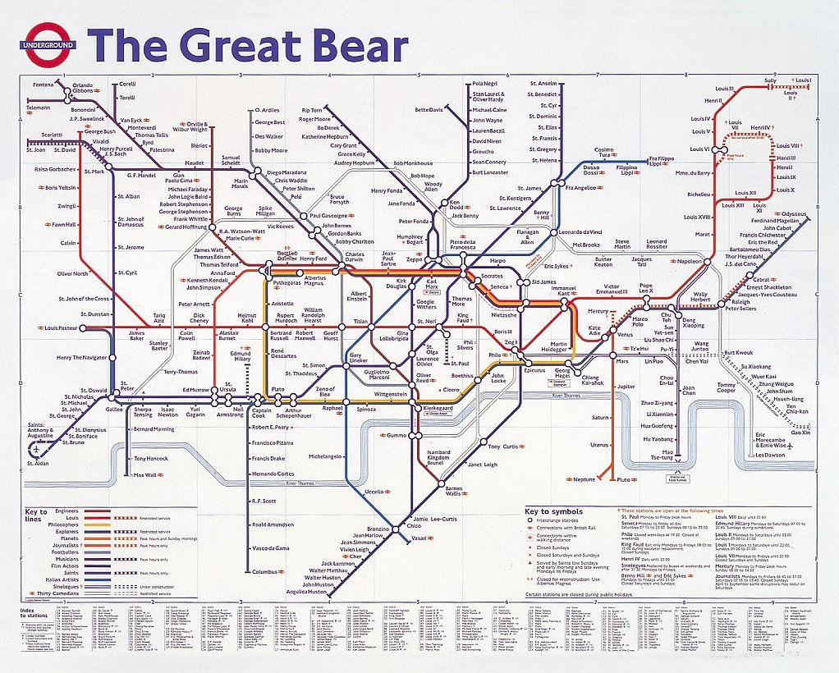
Simon Patterson
“The Great Bear” 1992 – links people of popular culture together.

