Slide 1
OBJECTS

Slide 2
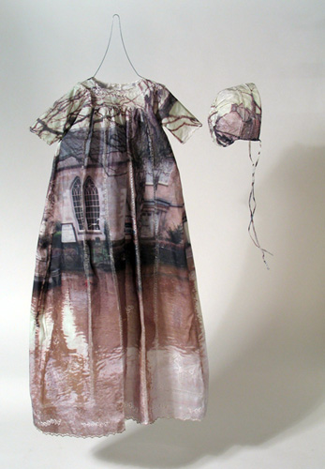
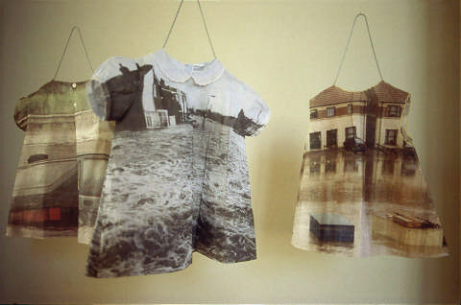
Shelly Goldsmith
‘No Escape’ -images of flood scenes had been transfer printed onto children's dresses.
Goldsmith’s work uses textile materials and processes as a metaphor for imagining how psychological states, emotions and memories associated with human fragility and loss can be made visible in cloth.

Slide 3
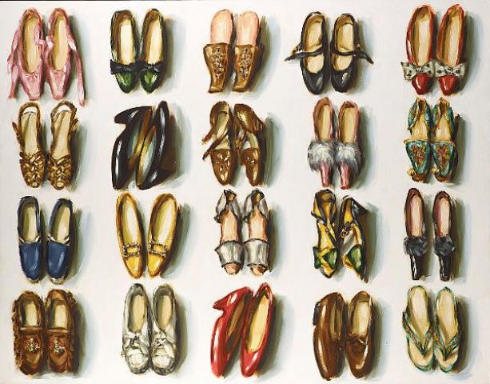
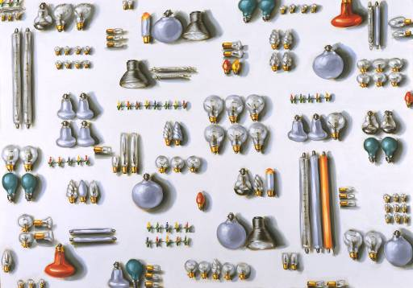
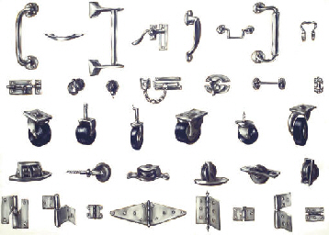
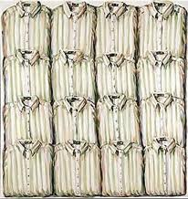
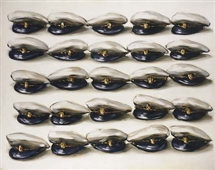
Lisa Milroy- collections of ordinary objects

Slide 4
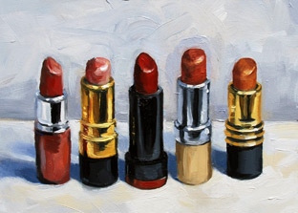
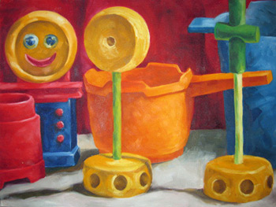
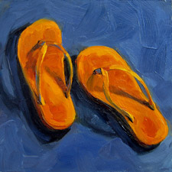
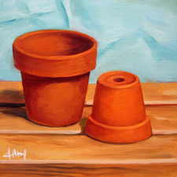
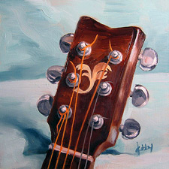
Kim Kibby
‘Five Lipsticks’ Oil on panel. 5x7 inches
Oil paintings of everyday objects
Tinker Toy Still Life - Oil on canvas
Summer Delight #2: Flip Flops – Oil on panel
Guitar Headstock -Oil on panel.
Little Clay Pots -Oil on panel.

Slide 5
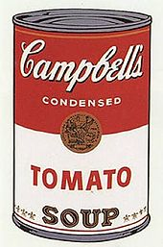
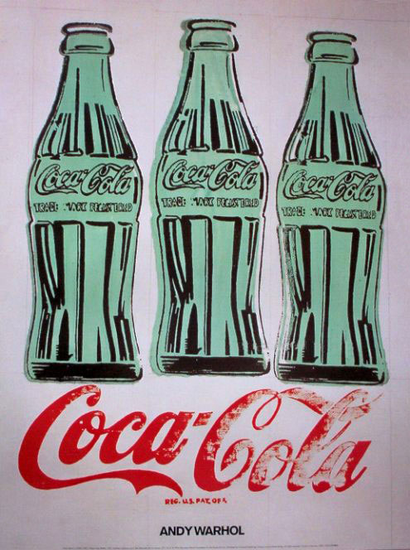
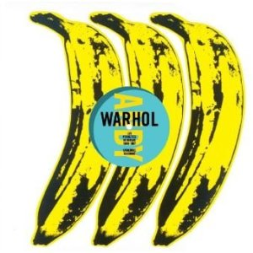
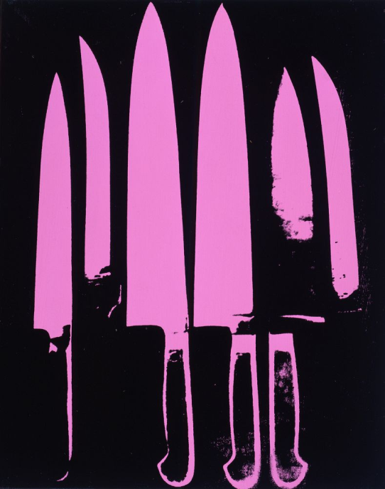
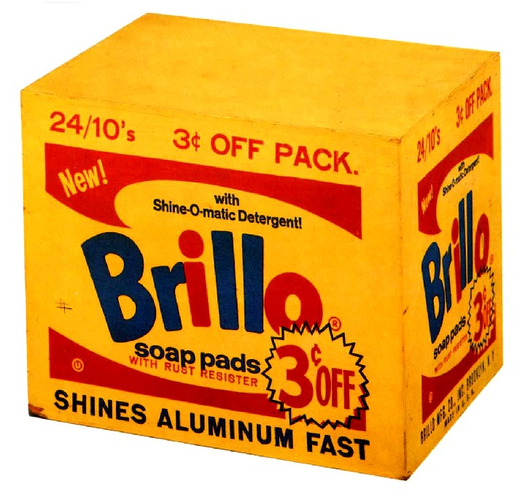
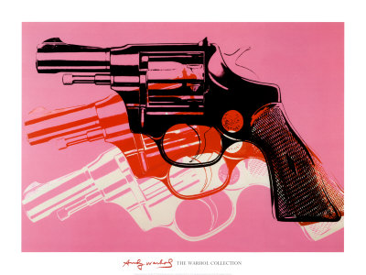
Andy Warhol- Ordinary Objects

Slide 6
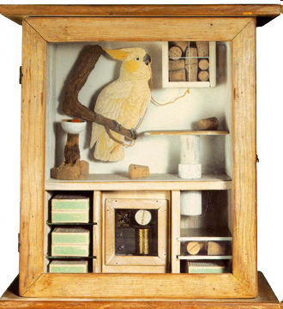
Joseph Cornell
Joseph Cornell’s Art work are collections of bought and found objects in boxes.
Cornell collected source material for his work, which became artistic creations about his inner thoughts, desires, and imagination.
‘Untitled’ (Cocatoo and Corks),
1948, 4 3/8 x 13 1/2 x 5 5/8 inchs.

Slide 7
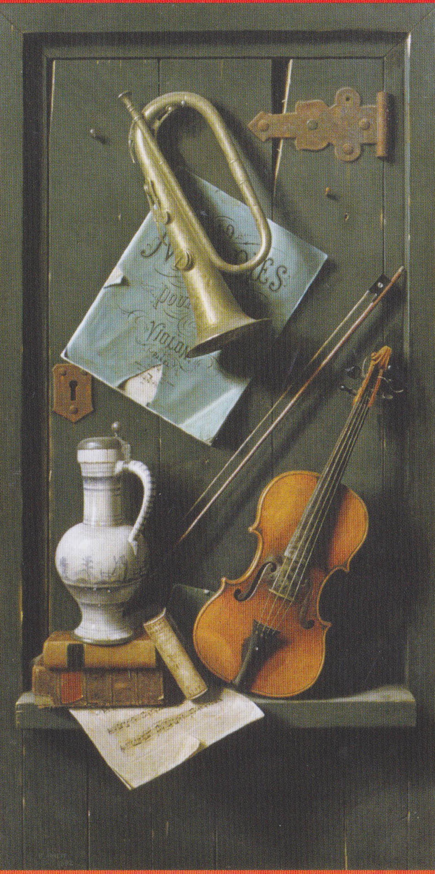
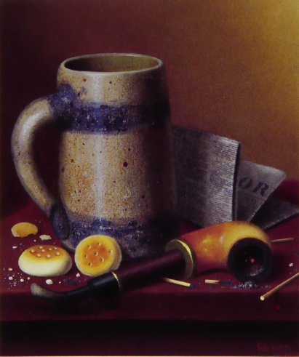
William Michael Harnett
Harnett was a very skilled painter. He wanted to make objects look as realistic as possible.
He used an assorted collection of everyday objects to create interesting compositions for his Art.
To the right: ‘Old Models’ 1892 Oil on Canvas
‘A Man's Table Reversed’ 1877 Oil on Canvas

Slide 8
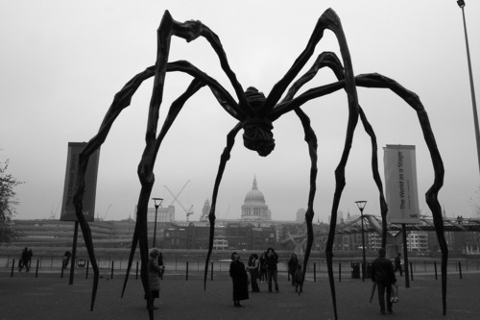
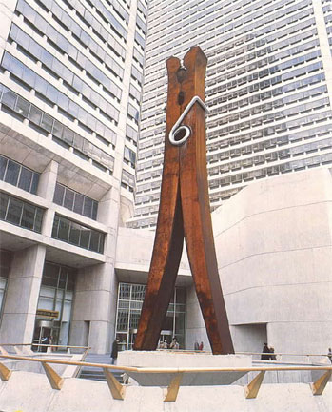
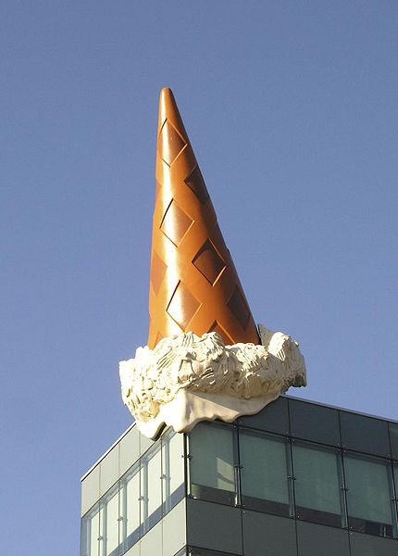
Small scale to large scale...
Louise Bourgeois – Maman, 1999. Bronze. “The Spider is an ode to my mother. She was my best friend. Like a spider, my mother was a weaver. Like spiders, my mother was very clever. Spiders are friendly presences that eat mosquitoes. We know that mosquitoes spread diseases and are therefore unwanted. So, spiders are helpful and protective, just like my mother.”
Claes Oldenburg. Pop artist. Very large replica sculptures of everyday objects, pictured in unusual places.

Slide 9
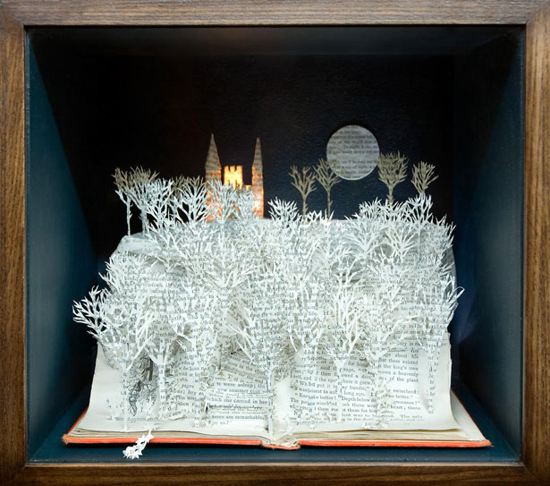
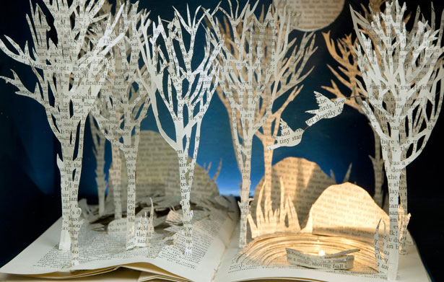
Su Blackwell – paper cut art

