Slide 1
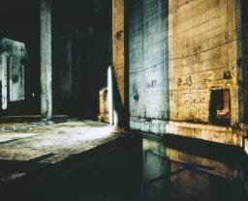
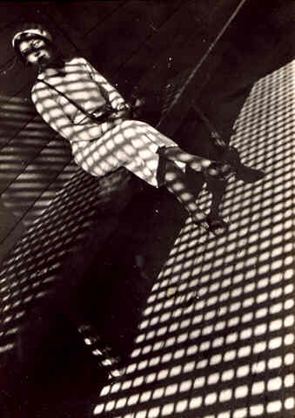
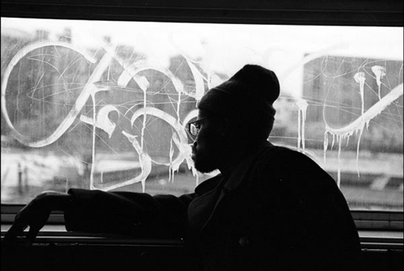
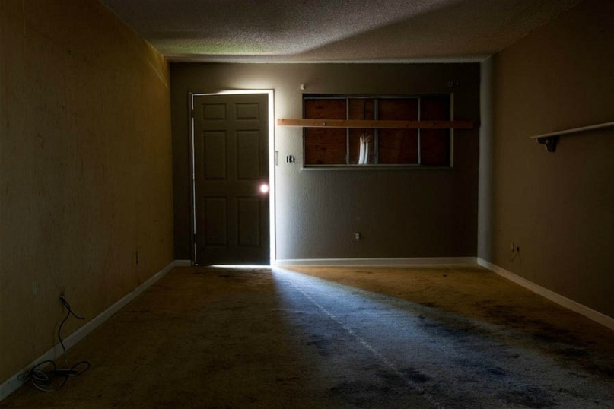
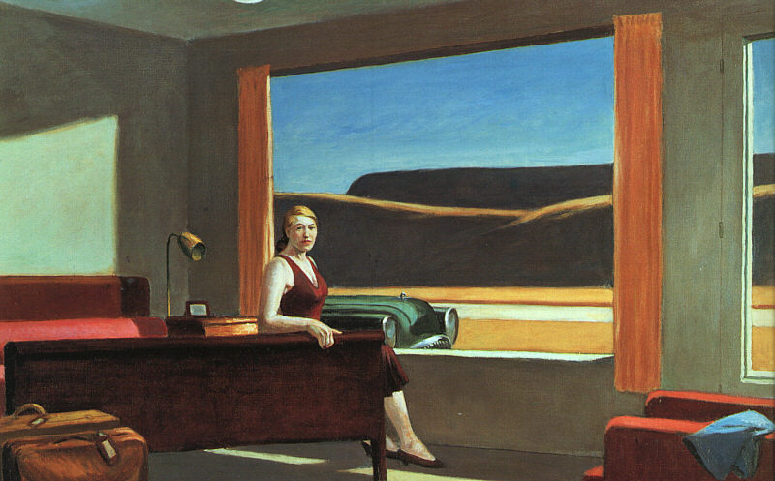
Light and Shadow
Roxanne Worthington
Christine
Sullivan
Alexander Rodchenko
Boogie
Edward Hopper
Kirk Crippen
Andrei Varga

Slide 2
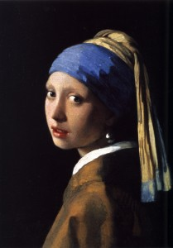
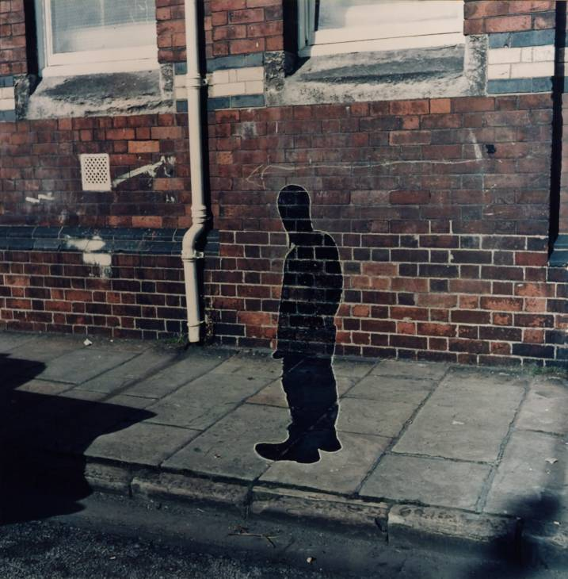
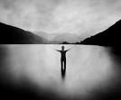
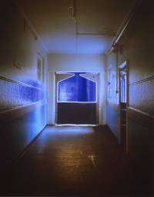
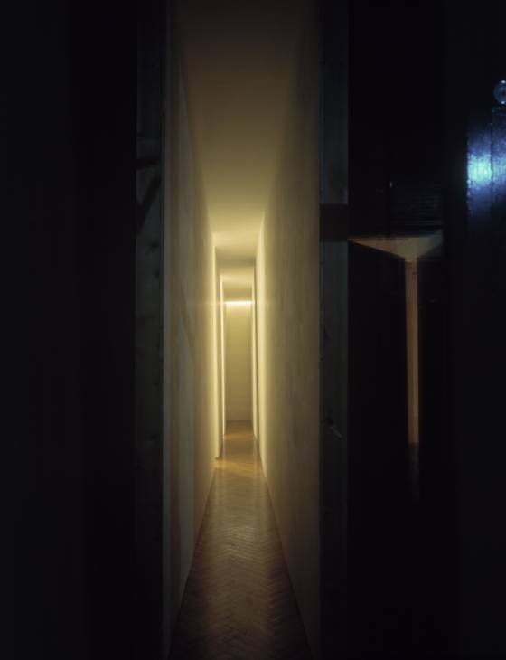
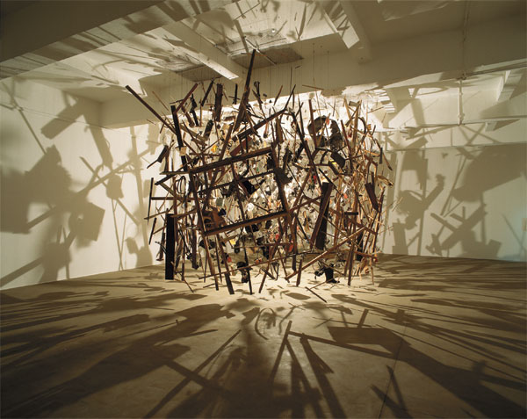
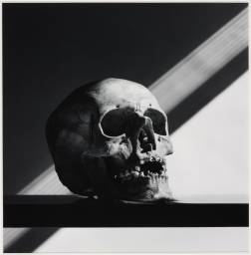
Light and Shadow
Anna Marienko Nature Sound Form Wave
Mark Tweedie (Pinhole)
Keith Arnatt
Vermeer
Katherine
Yass
Cornelia Parker (cold dark matter)
Robert maplethorpe
Bruce Nauman

Slide 3
, Andrea Hunter and Karen Kulyk
William Eggleston
http://www.bideford.devon.sch.uk/art/gcse07/viewpoints/index.html

Slide 4
Alevel galleries
http://frog.bideford.devon.sch.uk/index.phtml?d=170027
http://www.bideford.devon.sch.uk/art/galleries/alev_art_08/index.html
http://www.bideford.devon.sch.uk/art/art_images/galleries/a2%201/index2.html

