Slide 1
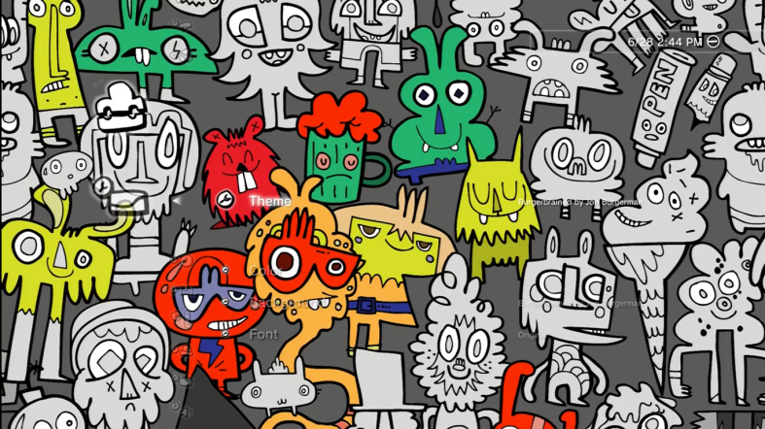
Jon
Burgerman
Burgerman images seem to have each been created in one burst of creative energy, his pen never leaving the paper once it has made contact until the image is complete. The result is that his drawings have a fresh immediacy that make them as fun as they are visually impactful. He refers to his work rather modestly as 'doodles' but really what he's doing is creating his own distinctive artwork at every available opportunity - whether it's on a pad of Post-Its just for fun, or on a larger scale in a variety of mediums for an enviable list of clients ranging from The Science Museum to Sky, Pepsi, Sony and Kidrobot.
Jon Burgerman creates his characters using vibrant shapes and colour. He’s pushed his monster-like characters into compositions where cartoon-like forms are crammed on top of each until they create a busy, screaming mass of energy. His characters are simple, but the range of designs and the variety of shapes and facial expressions that the feature, create original creatures.
Pick the key information plus explain your opinion of his work.
Jon Burgerman is an English born artist from the UK currently living in New York.

